Slide 1
Designing and Optimizing an Adenovirus Encoded VLP Vaccine against HIV
Anne-Marie Andersson
PhD Student, University of Copenhagen

Slide 2
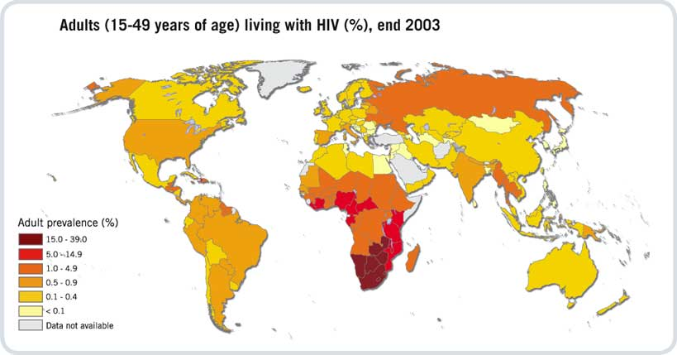
HIV Prevalence
WHO, 2003
> 2 million AIDS related deaths in 2008
> 33 million persons are living with HIV/AIDS
2.7 million NEW HIV infections occurred in 2008
Notes:
after 30 years of research: still no vaccine: Since still see high prevalence: 2.7 millions new, How can it be no vaccine yet??

Slide 3
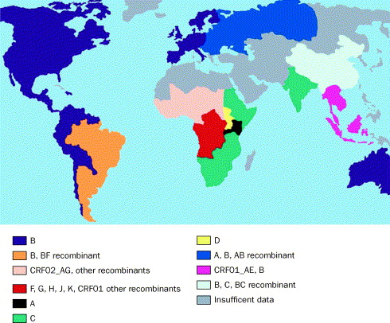
Challenges for the Development of HIV Vaccines
1. Viral diversity
DA. Garber et al., 2004
Notes:
The primary challenge: diversity. Not a virus of consistency. This map portrays the differences in various parts of the world. Whereas the map at first glance might catch our eye due to the kaleidoscope of colours, in the eye of a vaccine developer this is a nightmare scenario

Slide 4
Challenges for the Development of HIV Vaccines
2. Lack of clear correlates of protection
-natural infection fails to clear/eradicate the virus
-Humoral immunity: failure of producing immunogens able to induce neutralizing antibodies
-Cellular immunity: CD8 T cells suppress HIV replication though does not eradicate the infection
Notes:
In addition to this, we have the basic challenge of finding clear correlates of protection. And then if we look at the two arms of the immune system we’re faced with the facts that we

Slide 5
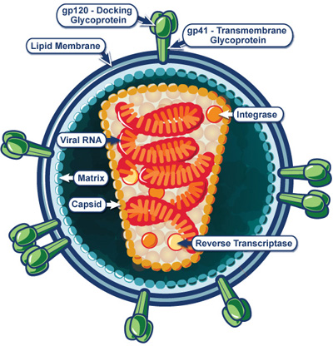
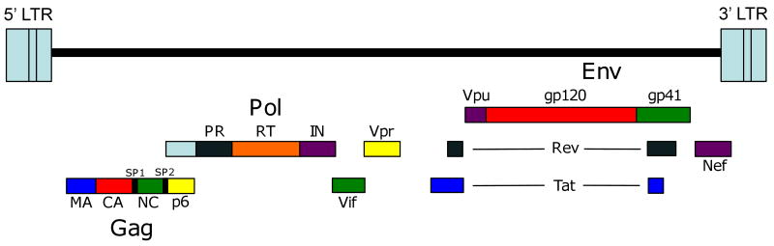
HIV Structure
Family/Genus: Retroviridae/Lentivirus
Viral envelope: proteins from host cell
env = gp120 + gp41 trimers (~72 copies)
Capsid: surrounds two single strands of HIV RNA
RNA encodes: three structural genes: gag, pol, env
  regulatory genes: tat, rev, nef, vif, vpr, and vpu
NIAID
Adamson CS, Freed EO., 2010
Notes:
If we briefly take a look at the hiv virus particle itself

Slide 6
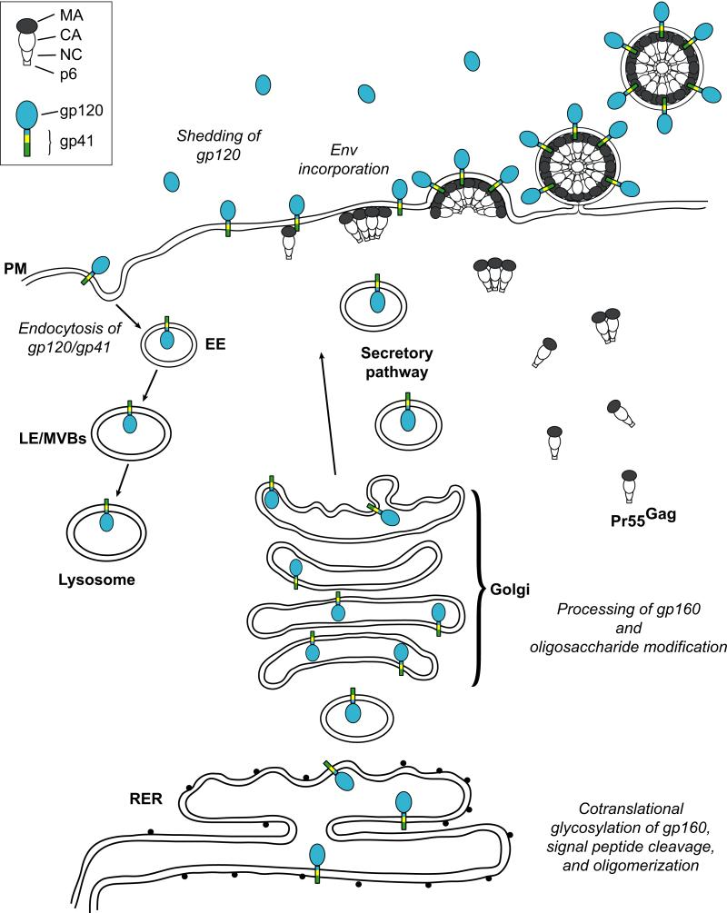
Targeting Env for Prophylactic Vaccine Development
Challenges:
        -rapid amino acid mutations
-glycan shield minimizes exposed epitopes
-steric constraints to ab binding
-presence of immature/decoy/misfolded env

Slide 7
Vector Design (1)
Replication deficient Adenovirus
  Deletion of E1 and E3 -incorporation of more than 7 kb
  Infects many different cell types
  Long lasting antigen expression
  Access to Ad5, Ch63, Ch3 strains

Slide 8
Vector Design (2)
  Allows for in situ virus like particle production
CMV
gag
env
stop
PolyA

Slide 9
Aim of the Study
Can one improve antibody potency by encoding an HIV VLP and modifying the env?
Is adenovirus secreting VLP advantageous to trimer secretion?
Is the induction of potent antibodies dependent on the number of env trimers expressed on the VLP surface, on how they are dispersed or a combination of the two?

Slide 10
Vector Design (3)
  5 env variants derived from HIV-M CON-S sequence: 2001 consensus of subtypes A, B, C, D, F, G (H. Liao et. al., 2006)
    Full length
    Ct trunc
    ∆CFI Ct trunc
    MMTV TMCT
    ∆TMCT
CMV
gag
env
stop
PolyA
CMV
gag
env
stop
PolyA
CMV
gag
env
stop
PolyA
CMV
gag
env
stop
PolyA
CMV
gag
env
stop
PolyA

Slide 11
Methods
Design verification: Western Blot
                Electronmicroscopy
                Immunogenicity studies: C57/bl6 mouse strain
Potency analysis: ELISA
Notes:
Day 0 prime, 7 weeks bleed 8 weeks boost

Slide 12
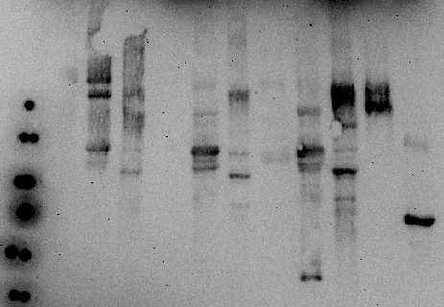
Results: Verification of Vaccine Constructs (1)
Kit purif.
Ultra purif.
Positive controls
÷DDT
+DDT
+DDT
+DDT
÷ virus
irr. virus
÷ virus
irr. virus
÷ virus
irr. virus
gp120
gp41
VLP virus
VLP virus
VLP virus
128
78
54
41
27
19

Slide 13
Results: Verification of Vaccine Constructs (2)

Slide 14
Results: Vaccine Immunogenicity
Week
0
7
8
15
16
23
Immunization/
Bleeding
Ad5
Ch63
Ch3

Slide 15
Conclusions and Future Perspectives
Confirmed VLP secretion
Confirmed immunogenicity
Analysis of potency of induced antibodies with pseudovirus neutralisation assay

Slide 16
Acknowledgements
LEV Team CMP
Peter Holst Ali Salanti
Emeline Ragonnaud Morten Agerskoug Nielsen
Birita Kjaerbaek Thor Theander
Michael T Loevendahl
Eydbjoerg Johannesdottir Funding
Iman Mohammed Lundbeck foundation
CFIM
Klaus Qvortrup

Slide 17
Thanks for listening!

