Slide 1
Effectiveness of drug interventions to reduce nevirapine resistance after single-dose nevirapine as part of antiretroviral prophylaxis to prevent HIV mother-to-child transmission; A systematic review and meta-analysis
Eva P. Muro BPharm,MSc

Slide 2
Outline
Background information
Objectives
Methodology
Results
Discussion and Conclusion
Acknowledgement

Slide 3
Background information
Mother-to-child transmission (MTCT) of HIV-1 is 30-45% in the breastfeeding population [De Cock KM et al 2000]
Combination prophylaxis (e.g. AZT + SD NVP) preferred
SD NVP only where other interventions not feasible. This should be the exception not the rule.
The prevalence of NVP resistance with or without antepartum antiretroviral drugs are estimated to be 36% [Arrive E et al 2007]

Slide 4
Study Objective
To compare the proportions of nevirapine viral primary mutations (mutations L100I, K101P, K103N/S, V106A/M, V108I, Y181C/I, Y188C/L/H, G190A) per drug intervention detected in plasma samples collected <3 months postpartum using population sequencing.

Slide 5
Outcome Measures
To assess an overall effect of AP AZT during pregnancy and IP SdNVP and the proportions of NVPR mutations.
To assess an overall effect of AP AZT during pregnancy , IP AZT/sdNVP with PP AZT and the proportions of NVPR mutations.
To assess effect of short course PP intervention on the proportions of NVPR mutations after Sd NVP
To assess the effect of the duration of PP intervention on the proportions of NVPR mutations after Sd NVP , measured using population sequencing.

Slide 6
Methodology
Search Strategy
A literature search for this review was performed in the MEDLINE database, the Cochrane Library and the EMBASE database.
The keywords and medical subject heading terms used in the search strategy:
‘pregnancy’,
‘prevention-of-mother-to-child-transmission’,
‘nevirapine’,
‘viral drug resistance
Type of intervention did not matter
Data extraction
Single reviewer and counter checked by a second reviewer

Slide 7
Data analysis
Model of pooling results
Random effect models
NVPR and its 95% confidence interval (CI) was presented in a forest plot.
Effect summary per type of intervention and NVPR and its 95% CI were calculated using Microsoft Excel (Microsoft, Office 2007; Redmond, Washington [Neyeloff JL et al]).

Slide 8
Methodology
Heterogeneity among studies was assessed by Q (significant when p-value <0.05)
Observed heterogeneity was assessed by I² (ranging from 0-100%).
Quality of evidence
Based on five predefined GRADE criteria[Guyatt GH 2011]
Quality assessment
RCTs) the guidelines for systematic reviews of the Cochrane Collaboration Back Review Group [van Tulder MW1997, Furlan AD 2009].
Observational studies STROBE guidelines were used to assess the quality.[Guyatt GH 2011].

Slide 9
Results
A study of 823 reviews
Only 18 met the eligibility criterion
9 Randomized Clinical Trials
9 Observational studies
18 studies contained NVPR
24 study arms measured by population drug resistance assay
18 study arms measured by more sensitive genotypic technique

Slide 10
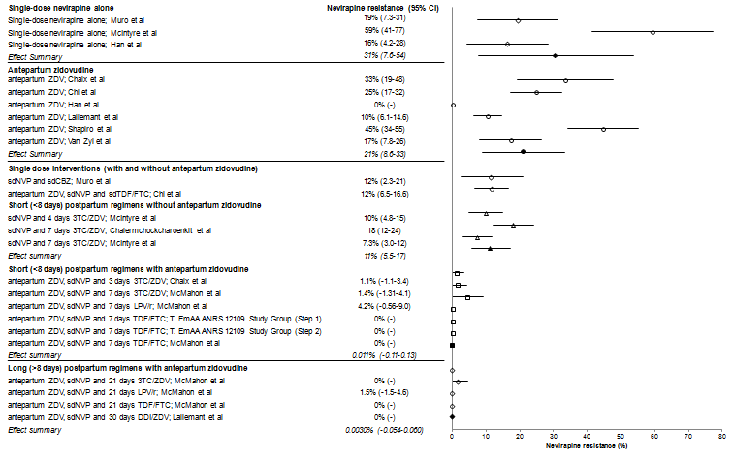
RESULTS

Slide 11
Results ….1
Anterpartum Zidovudine
Heterogeneity
P< 0.005
I²=88%, effect summary 31% (95% CI : 7.6 -54)
Heterogeneity
P< 0.005
I²=97% effect summary 21% (95%CI: 8.5-33)
AP AZT with SdNVP shows a decrease of 32% in the proportion of NVPR compared to SdNVP
Quality of evidence very low (0 points in the grade range of 0-3)

Slide 12
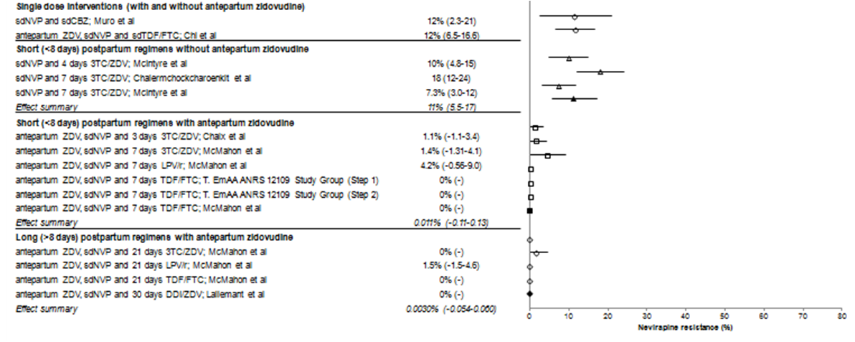
Results ……2
11 arms intervention PP <8 days
arms with same PP intervention-3 without AP AZT( effect summary [11% (95% CI: 5.5 -17) p value <0.005 , I² =75 ]and 2 with AP AZT effect summary [1.2%(95% CI: -0.48 -2.9) p>0.05, I² =75 ]
Quality of evidence low ( 1 point in the grade range of 0-3)
3 different short (<8days ) PP
3arms TDF/FTC
1arm LPV/r
2arms 3TC/AZT
0.011%(95% CI,-0.11-0.13)
P>0.5, , I² =0 Grade score 0
Effect AP AZT on NVPR with the same PP interventions

Slide 13
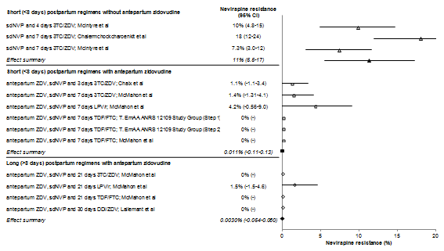
RESULTS…3
Duration of long course PP drug intervention
21 days
3TC/AZT or LPV/r or TDF/FTC
30days
DDI/AZT
Estimated pooled proportion for NVPR 0.003% (95% CI 0.052-0.06)
p> 0.05, I² =0%
Quality of evidence moderate
( 2 points in the grade range of 0-3)

Slide 14
Discussions 1
Current | Similar Study | Remarks
NVPR after a single-dose nevirapine combined with AP zidovudine was ~30% lower to 21% | values are consistent with previous studies 36% in mothers exposed to single-dose with or without antepartum zidovudine[Arrive E 2007, Martinson NA2009, McIntyre J2004] | Similar results to data obtained from meta-analysis
SdNVP was combined with AP AZT and a long course PP regimen Estimated pooled effect was nearly 0% and most effective by protecting the sub-therapeutic NVP ‘tail’ | McMahon et al evaluating long Vs short course subjects on 21-day regimens or longer were significantly better than seven-day regimens. | Long course PP intervention reduces occurrence of NVP resistance mutations

Slide 15
Conclusions
AP AZT + PP antiretroviral drugs postpartum have shown to nearly eliminate NVPR – below detection levels
20-30 days PP regimens appear to be more effective compared to a short (<8 days) PP regimen
The WHO guideline option A (AP AZT, SdNVP and one week of 3TC/AZT PP should be followed to achieve a feasible minimum risk of NVPR in regions where SDNVP is still being used (new guideline, 2010).

Slide 16
Acknowledgements
Sponsoring programme:
NWO(The Netherlands) through PRIOR
European and Developing Countries Clinical Trials (EDCTP) through VITA
Radboud University Nijmegen Medical Centre (NL)
Prof. David Burger
Prof. Wil Dolmans
Kilimanjaro Christian Medical University College (KCMUCO)
Dr. Elton Kisanga
Kilimanjaro Christian Medical Center
Kilimanjaro Clinical Research Institute

