Slide 1

MULTIDRUG RESISTANT-TUBERCULOSIS (MDR-TB) IN TANZANIA:APROACHES TO IMPROVE MANAGEMENT.
“Plasma drug activity in patients on treatment for multidrug-resistant tuberculosis”
Presenter: Stellah G Mpagama MD, MSc, PhD Cand.
KCMU-College Tanzania.

Slide 2
Definition of terms
C_{2hr -} Drug concentration in the blood/plasma attained 2 hours post medication
C_{max -} Maximum drug concentration attained in the blood within 24 hrs post medication
First line anti-TB – Medication used to treat common TB (Rifampicin,Isoniazid,Pyrazinamide and Ethambutol)
Secondline anti-TB – Medication used to treat MDR-TB [Injectables (kanamycin,amikacin,capreomycin) Flouroquinolone class (Ofloxacin,Levofloxacin and Moxifloxacin),Group 4 (Ethionamide,Cycoserine and Para-aminosalyclic acid)]
MDR-TB- Invitro resistance of Mtb isolates to at least both Isoniazid and Rifampicin
XDR-TB- Invitro resistance of MDR-TB isolates to at least one injectable and flouroquinolone class

Slide 3
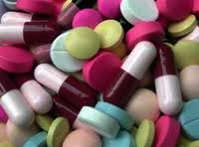
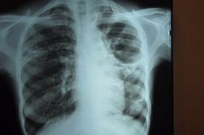
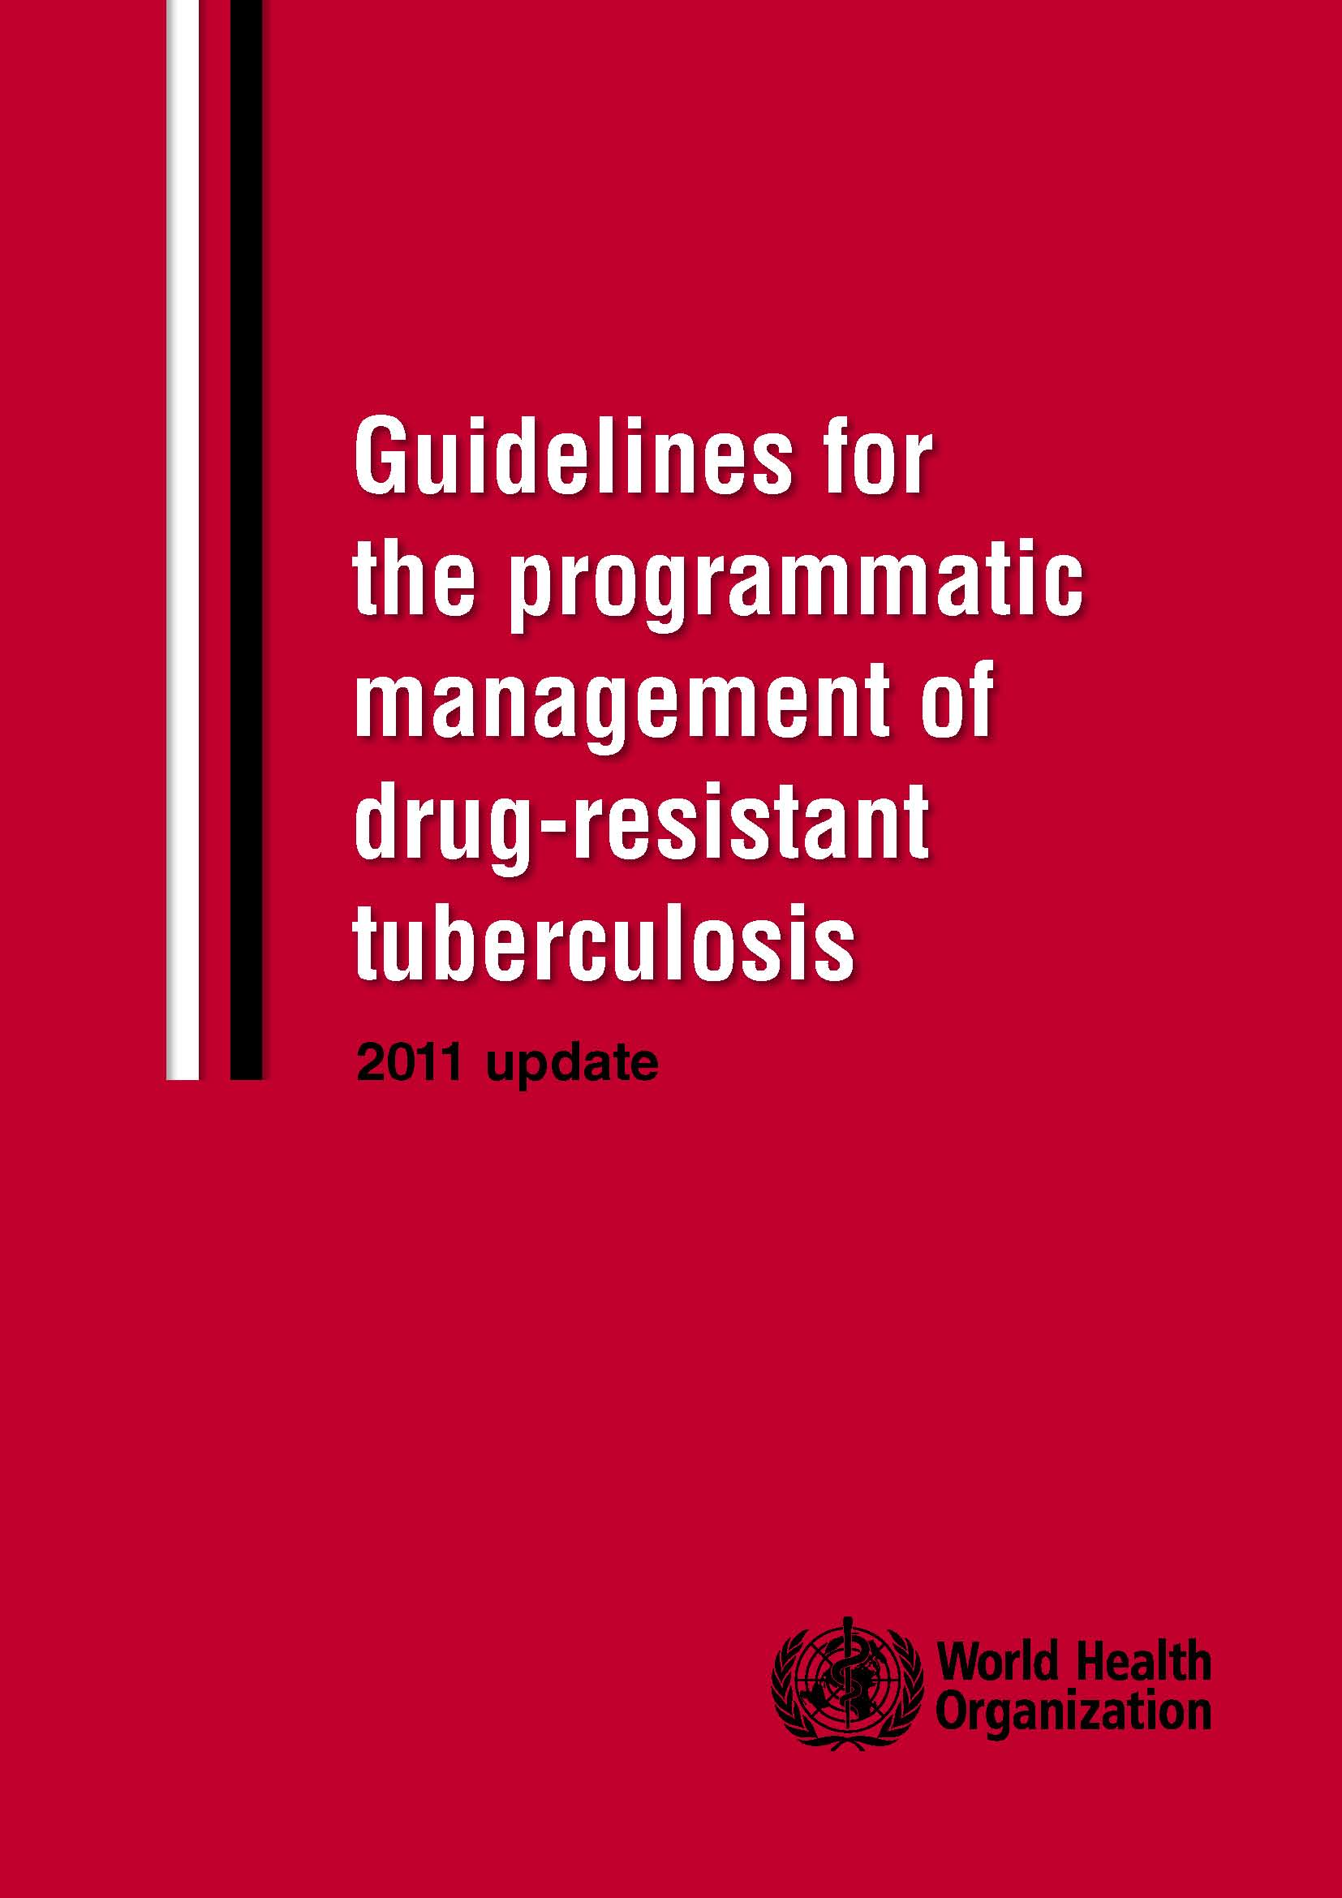
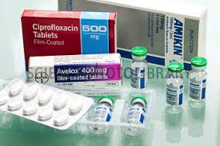
Background
Treatment outcome for MDR-TB patients remains inferior to DS-TB
Injectables
Tablets
Secondline TB drugs
- Less potent
- Requires extended treatment duration ~ 2years
Murine models
Human experiments
Demonstrates the importance of optimized drug exposure
Greater bacterial killing
Better treatment outcome

Slide 4
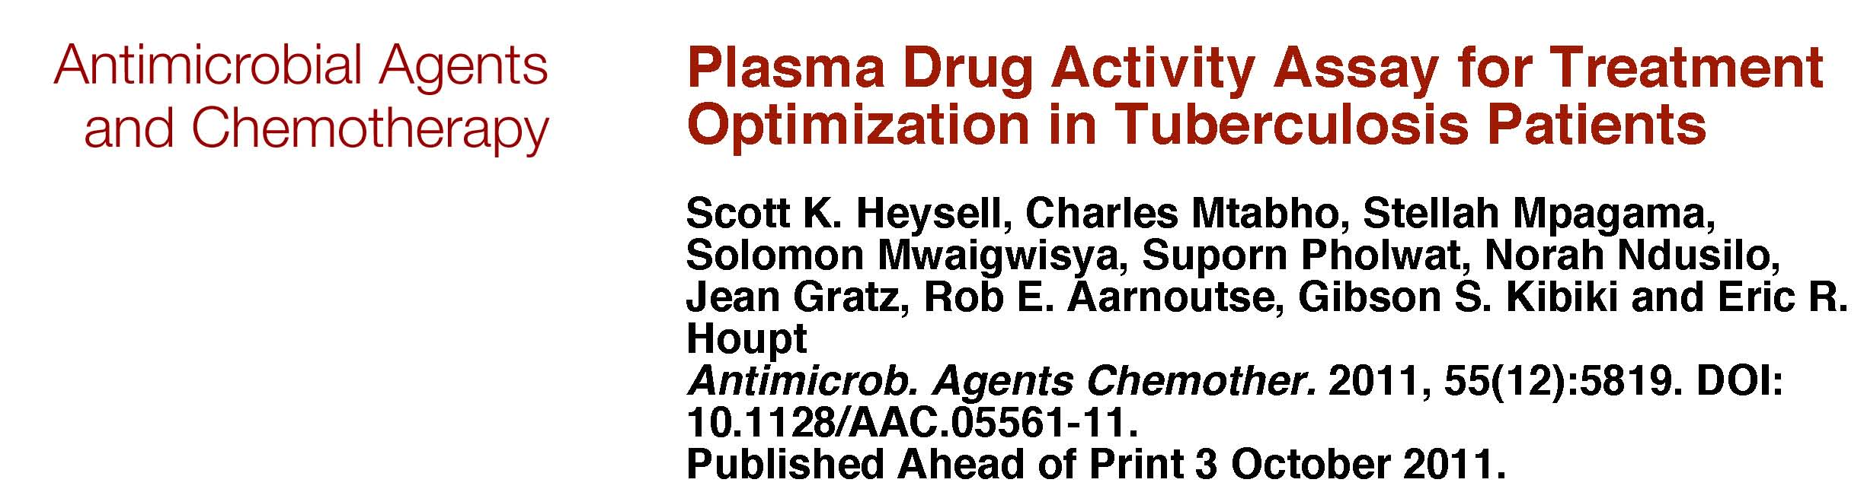
Background ……………….
Pharmacokinetic tools such as HPLC are not readily available in most of
TB endemic setting like Tanzania
We have previously described the role of TB Drug Assay (TDA) in patients treated
for common TB in Tanzania
Based on

Slide 5
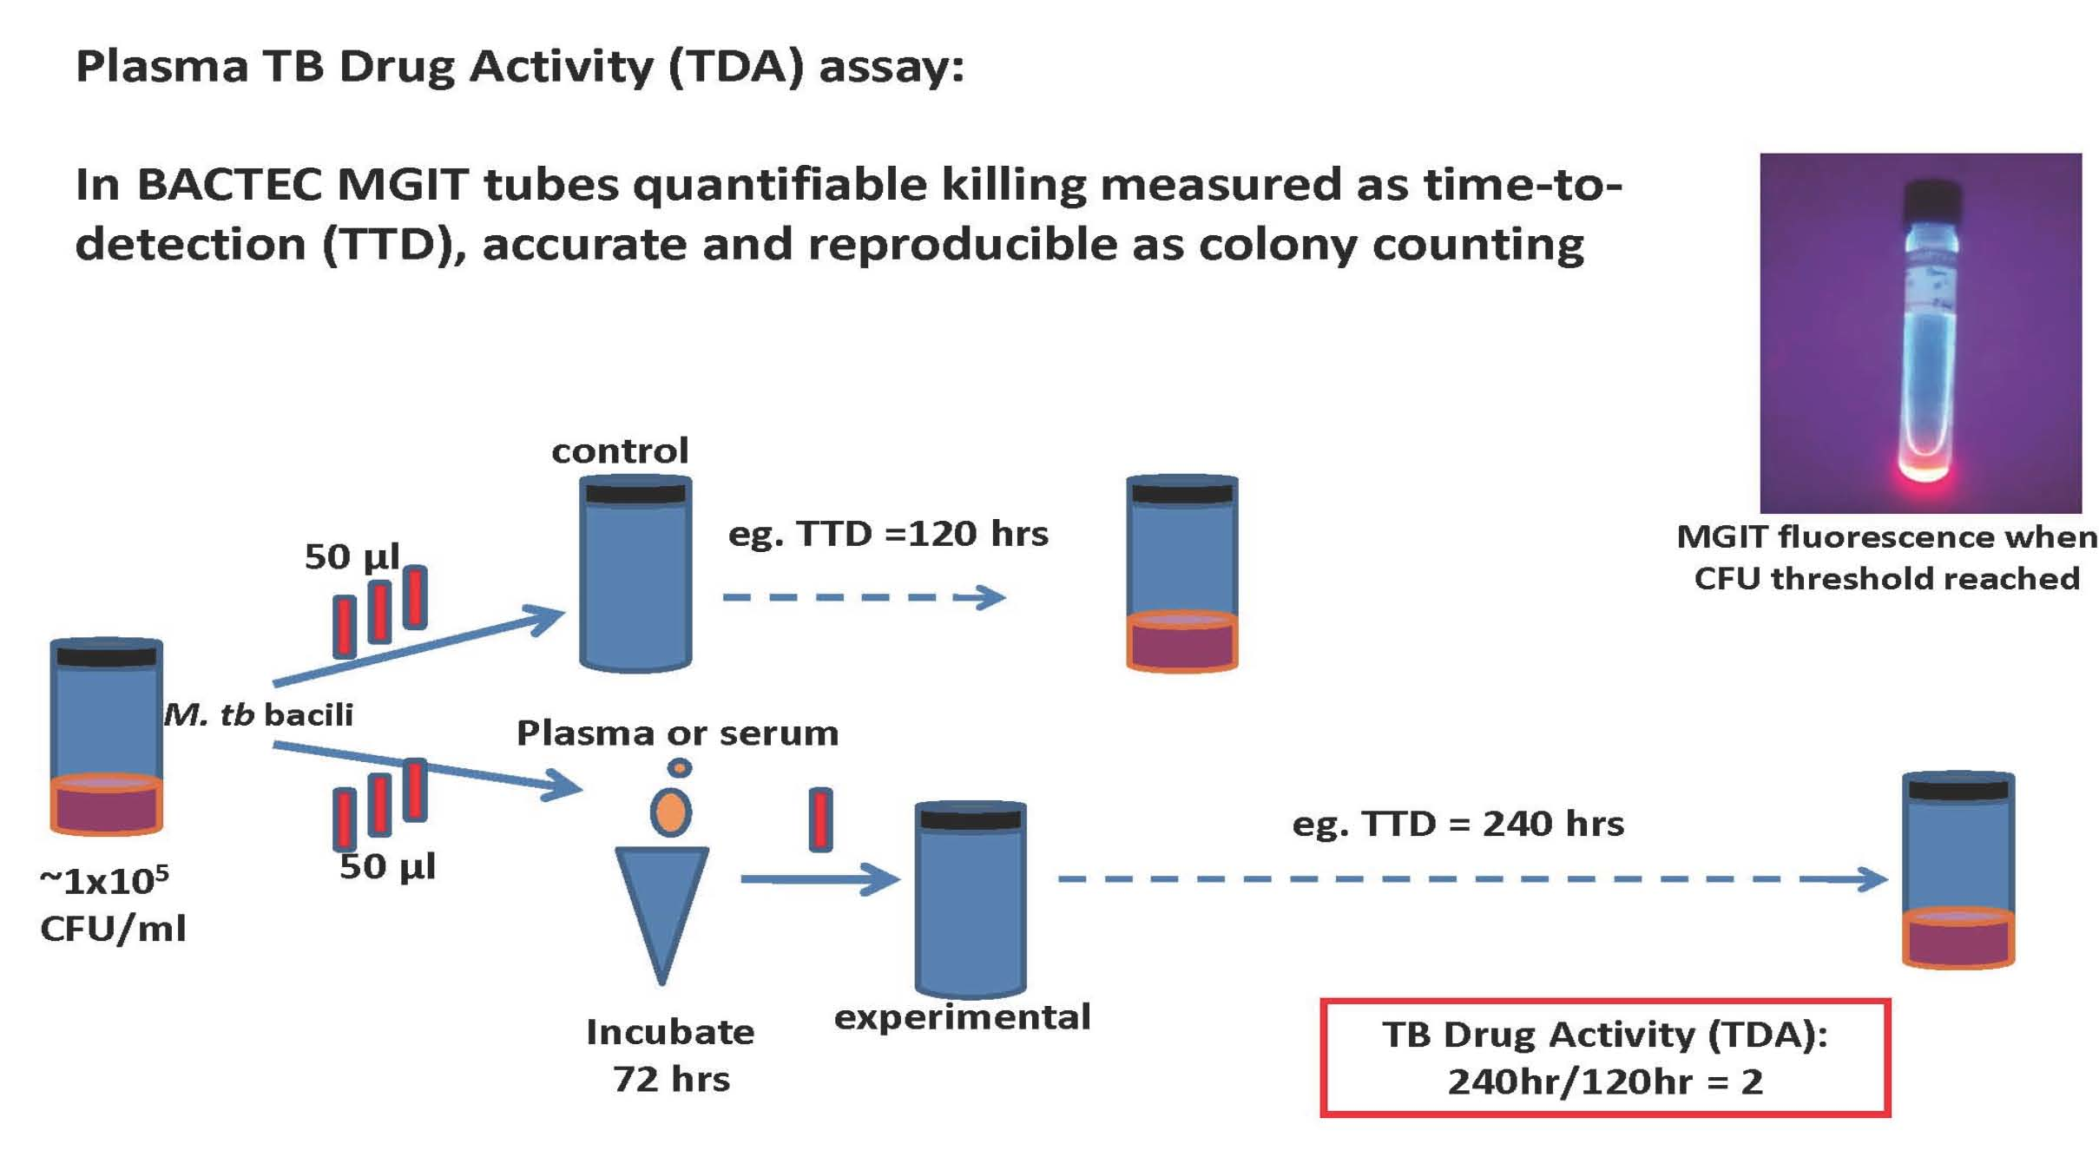
Background ……………….
TDA = Time to positivity in experimental
Time to posivity in control

Slide 6
Background ……………….
Findings of the previous TDA study
TDA correlated with drug concentration/MIC for Isoniazid and Rifampicin
TDA of < 1.0 indicated presence of MDR-TB at Kibongoto hospital
Low TDA, < 2.0 was significantly associated with both lower Isoniazid and Rifampicin concentration C2hr concentrations [Time estimated to Cmax]
Very Low TDA < 1.5 corresponded to a trend toward lack of cure
Understanding the relative activity of an individual patients MDR-TB regimen may inform treatment decisions particularly in the presence of poor response to therapy

Slide 7
Background ……………….
Therefore in this study, We examine
Plasma drug concentrations
MIC of drugs
Relative activity of each drug in the TDA assay
Weather TDA can be used as a predictor of early treatment
response (measured as time to culture conversion)

Slide 8
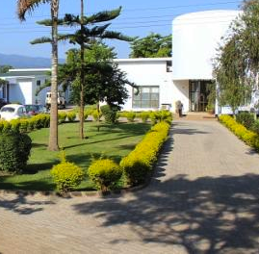

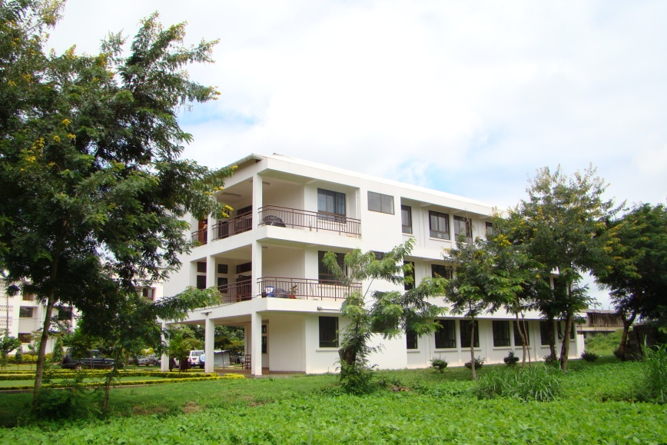
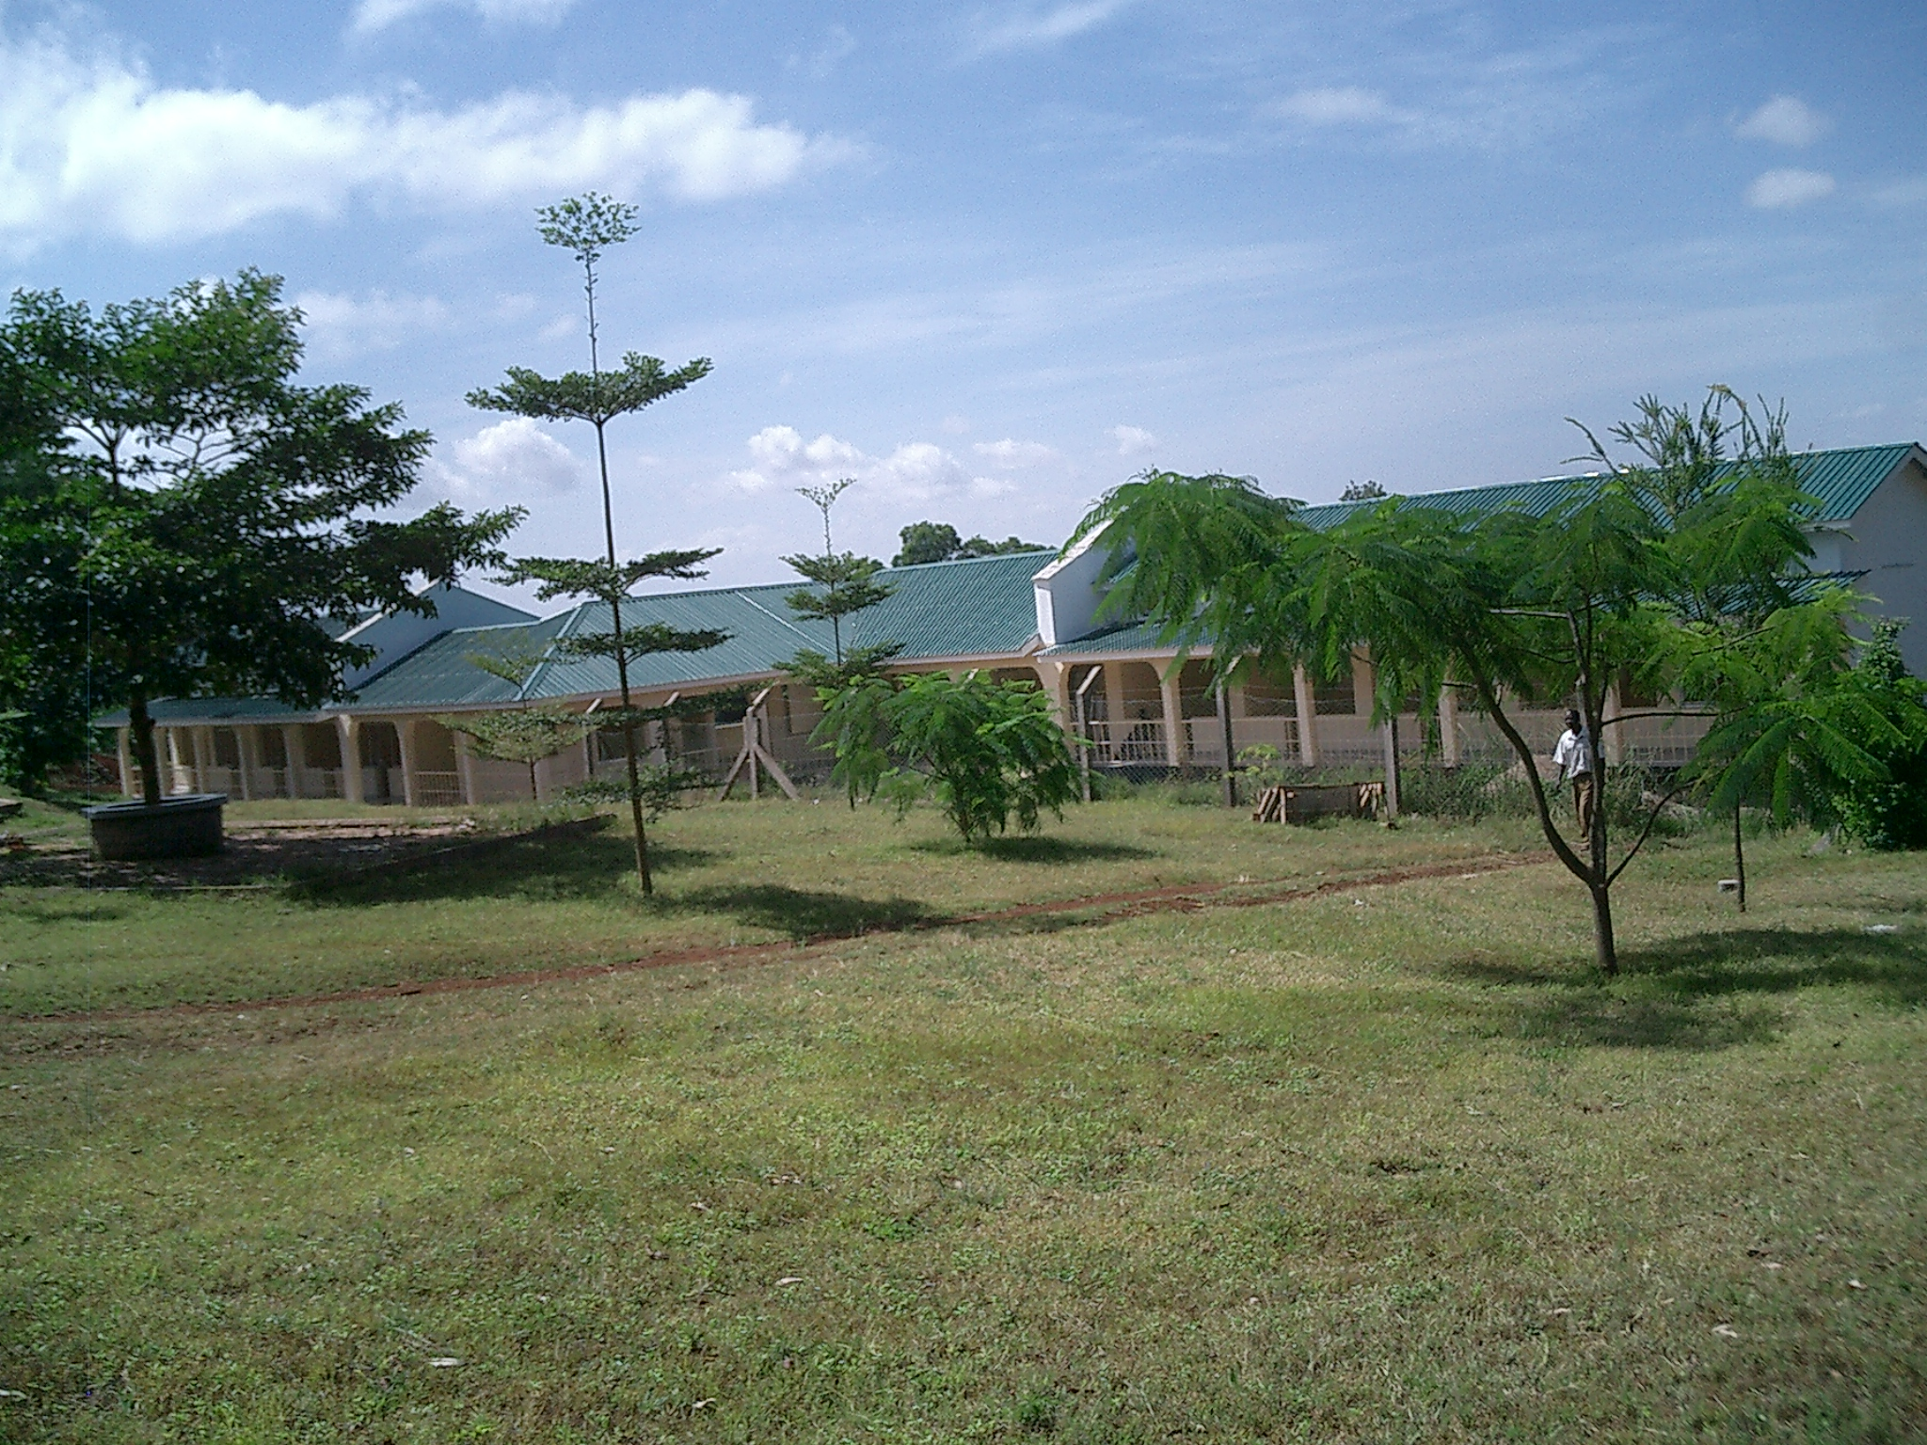
Methods
Biotechonology Lab
Study design ; Explanatory TB Diagnostic trial.
Study site
United states of America
United Republic of Tanzania
Kibongoto MDR-TB
Centre of excellence
K C R I

Slide 9
Material and Methods in Virginia –United States of America
Mtb isolates with known resistant
Patterns MDR and XDR-TB
A health tuberculin skin test negative
Volunteer donate blood
Plasma spiked with secondline TB
Drugs. Pyrazinamide,Ethionamide,
Cycloserine, Ofloxacin,Moxifloxacin
Kanamycin and Amikacin
Repeat DST using conventional 1%
Proportion testing except Pyrazinamide
DST performed in specifc Bactec MGIT media
Achieve concentration within
The exposed Cmax for the drugs
MIC performed for all drug except
Pyrazinamide in MYCOTB Sensititre plate
TB Drug Assay

Slide 10
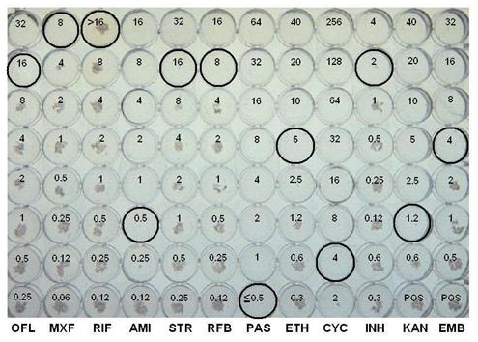
Material and Methods-Kilimanjaro, United Rep Tanzania
Informed consent to MDR-TB patients
Blood collection 2hrs and at least 2 weeks post medication
Pre treatment sputum collection
Plasma/Serum
Culture in isolates
Second line TB drug levels measurement
MIC using MYCOTB
Sensititre plate
Plasma Drug Assay
Levofloxacin (HPLC)
Ethionamide (HPLC)
Cycloserine (CA)
Pyrazinamide (GCMS)
Kanamycin (LCTMS)
Picturrepppppppppppppppp

Slide 11
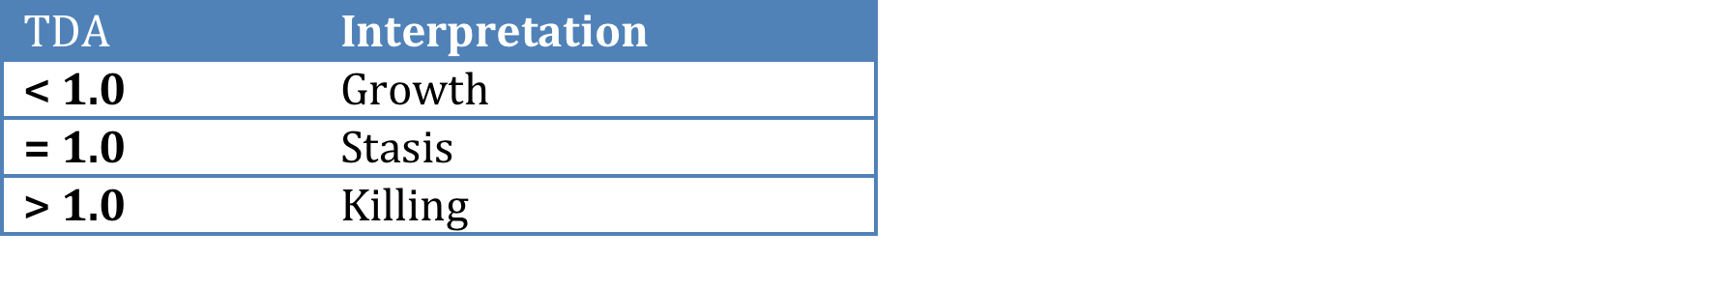
Data analysis
Mtb TDA experiments were performed in duplicate at KCRI
Means were compared using a t-test and standard deviation
Medians compared by the Mann-Whitney test
Correlation of continuous variable –Pearson’s coefficient

Slide 12
Results- Virginia-USA
3 –MDR-TB isolates
1- XDR-TB isolate

Slide 13
Results- Virginia…………………….
Figure 1- TDA of different drugs.
PZA – Growth
Ethionamide
Cycloserine
Kanamycin vs Amikacin
Ofloxacin vs Moxifloxacin

Slide 14
Results- Virginia…………………….
TDA checkerboard of increasing concentration of moxifloxacin and kanamycin against M/XDR
Figure 2a: XDR isolates
Figure 2b: MDR isolates

Slide 15
Results- Virginia…………………….
Additive dose response relationship was observed at the lowest concentrations of
Moxifloxacin and Kanamycin with MDR but not the XDR strain
Regimen used in the standard MDR-TB treatment at Kibong’oto
[Kanamycin, Ofloxacin, Ethionamide ,Pyrazinamide and Cycloserine]
Mean TDA = 1.57 ± 0.17
When Moxifloxacin was substituted for Ofloxacin
Mean TDA = 1.80 ± 0.17
The increase was significant (p = 0.03)

Slide 16
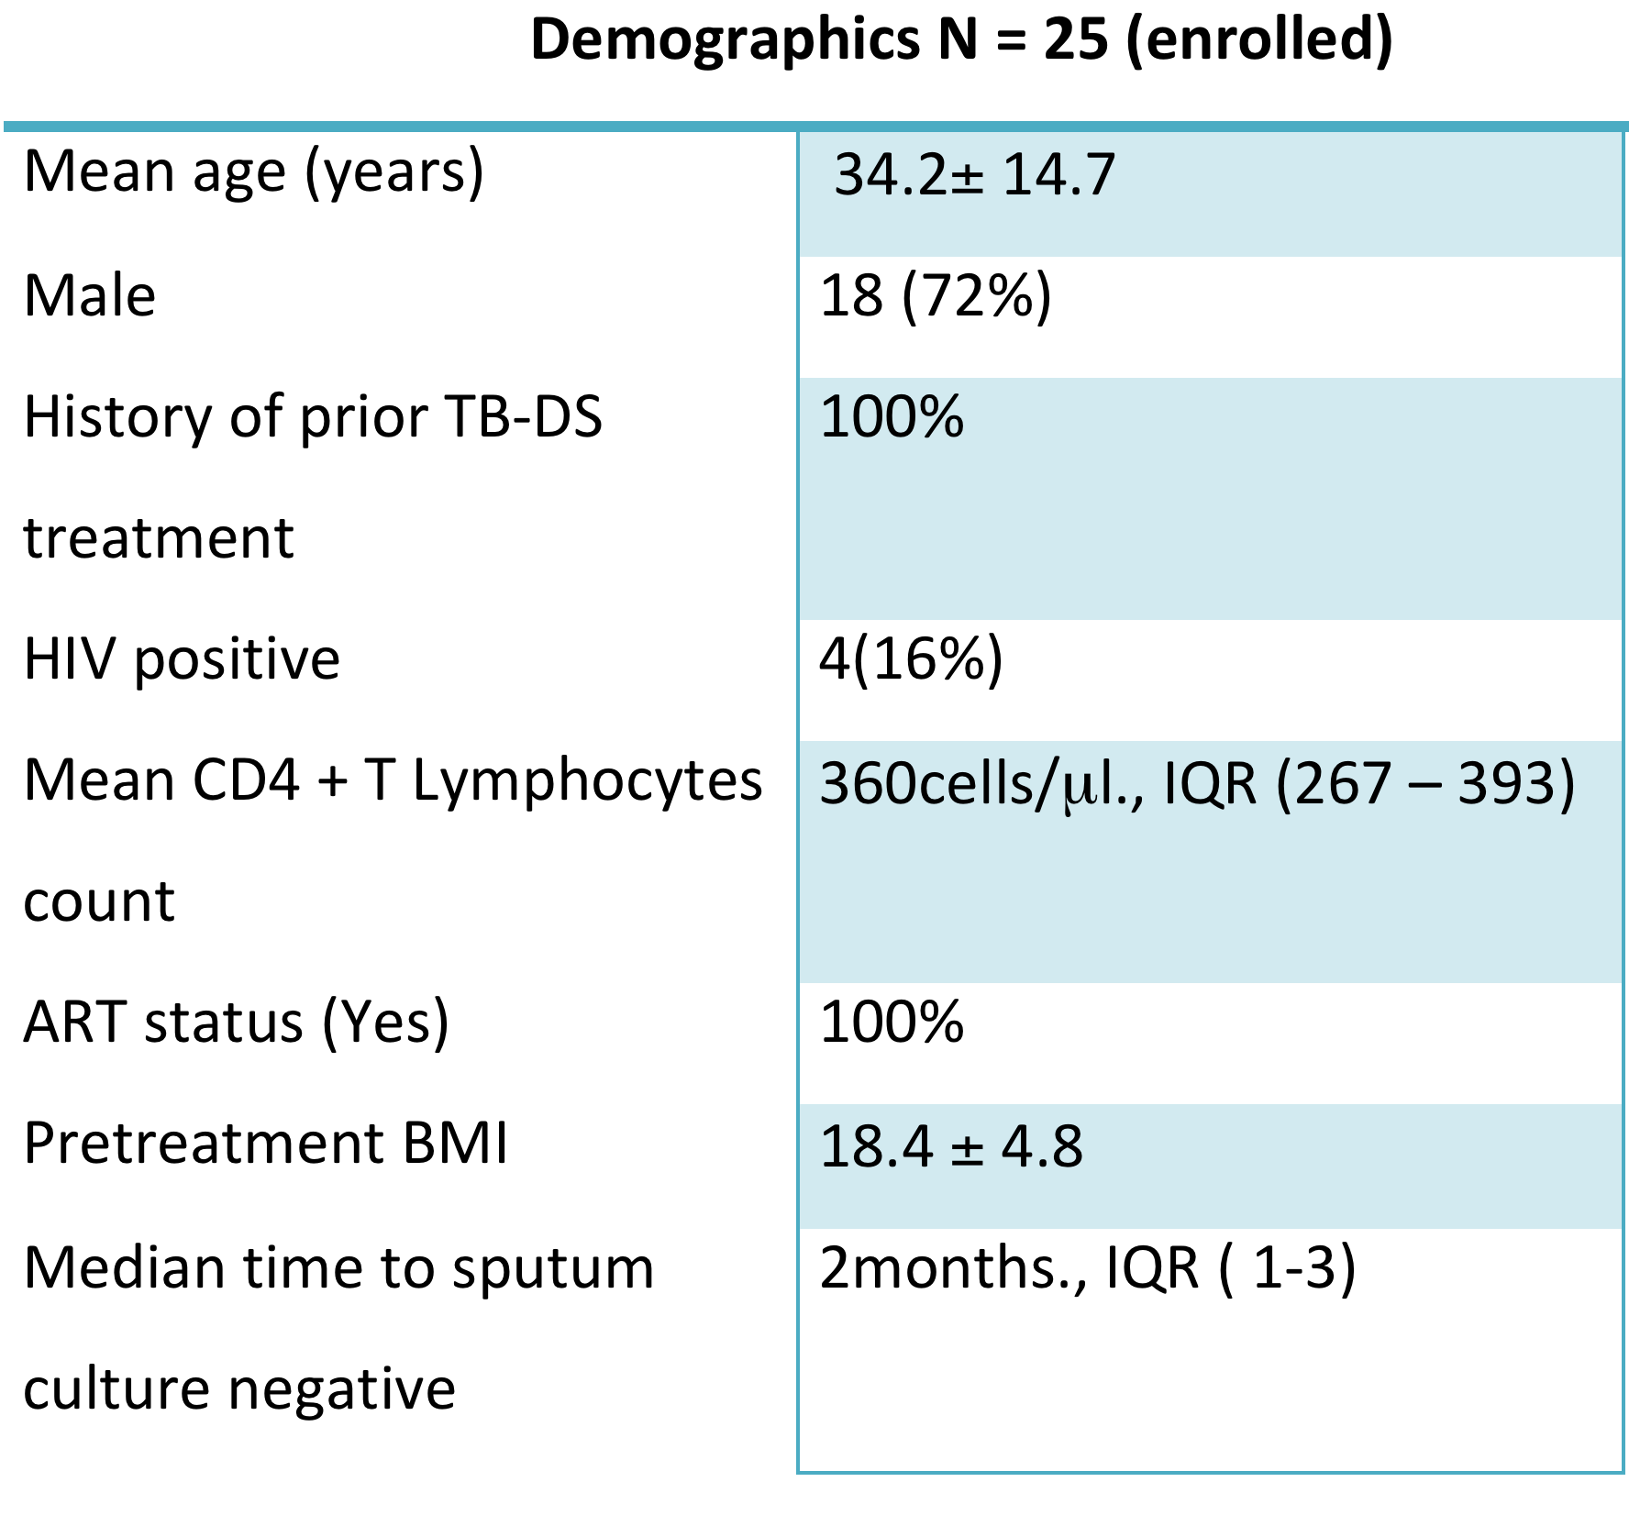
Results - Tanzania

Slide 17
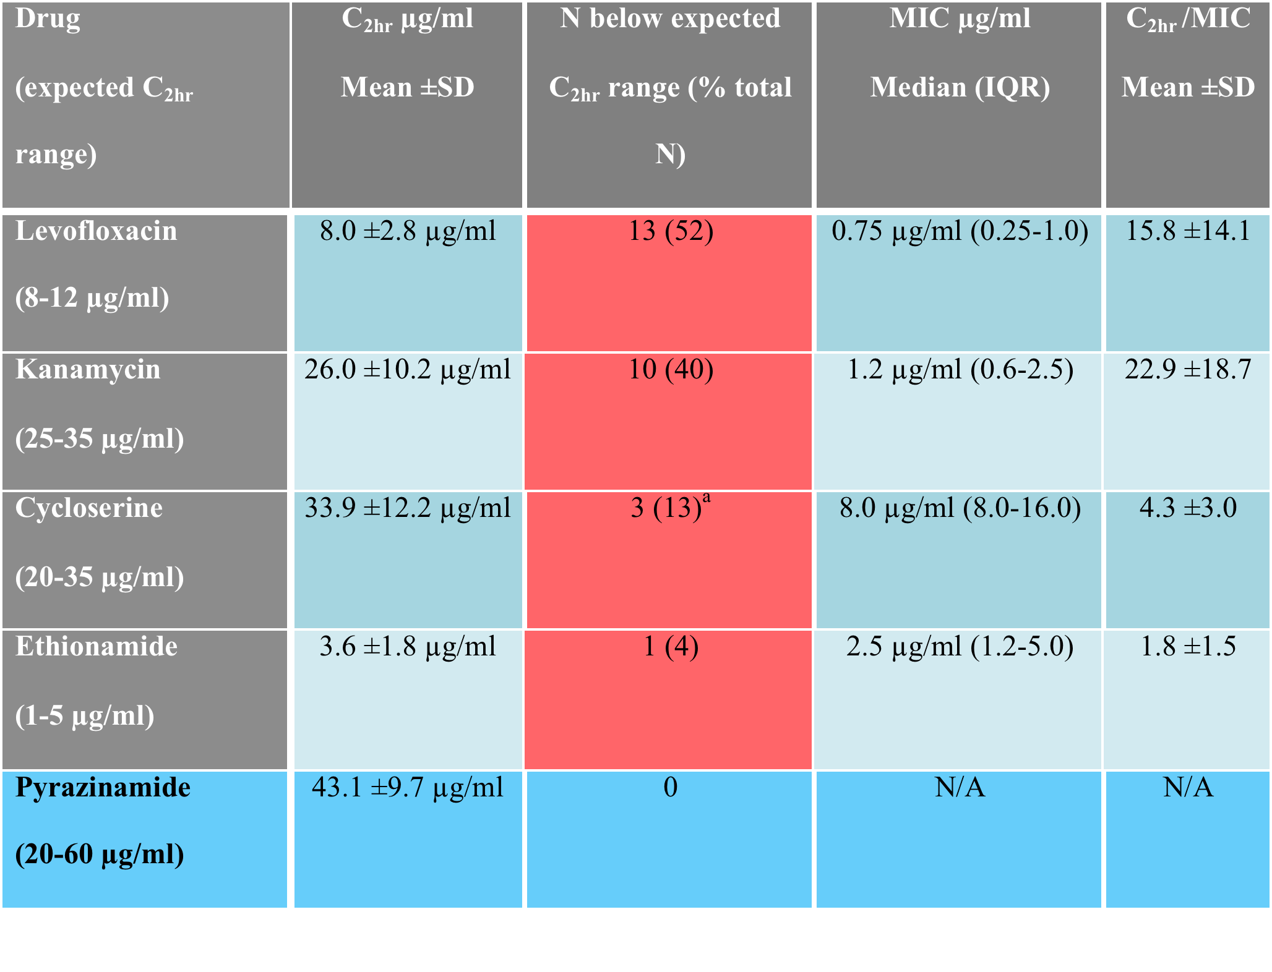
Results - Tanzania
Table 1. Drug concentrations (C_{2hr}) and C_{2hr}/ minimum inhibitory concentrations (MIC) in patients on treatment for MDR-TB

Slide 18
Results - Tanzania
TDA distribution and correlation with C2hr/MIC
Pharmacodyanamic
proxy
Mean Time to Positivity 104.8 ± 16.0 hours
Mean TDA for -2logkilling was 1.9 ± 0.48 (did not differ with Virginia experiment
Mean TDA of subjects while on MDR-TB regimen was 2.25 ± 0.55 (min/max 1.42- 4.9
Figure 3
Comparison of the mean
C2hr/MIC in patients with
Very low TDA

Slide 19
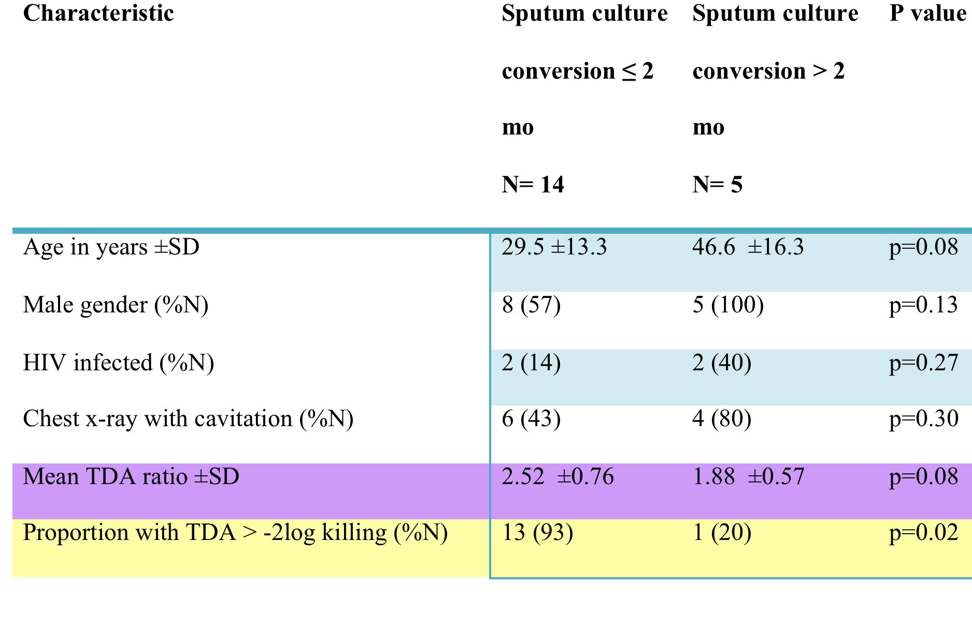
Results - Tanzania

Slide 20
Discussion
In this study of Plasma Drug Activity
Concentration of Levofloxacin and Kanamycin were frequently
the expected range
This is a critical observation as quantitative susceptibility for
M.tb may become increasingly available and pharmacokinetic
targets for SLD concentrations relative to MIC are not
definitely established
[Hall et al, 2012: Scarporo et al 2004]

Slide 21
Discussion………………
While
Application of individual SLD concentration
or
MIC measurement requires further prospective study
Subject from Tanzania that had a faster time to sputum culture
conversion were more likely to have a TDA value in
excess of -2log killing

Slide 22
Discussion
While
There have no completed randomized trials to guide treatment
duration for MDR-TB
Our findings
Suggest opportunity for study of optimizing pharmacokinetics to
hasten culture conversion or ultimately shorten treatment
duration

Slide 23
Discussion
For example
In a recent comparison of ofloxacin AUC/MIC on MDR-TB patients
in South Africa, only 45% achieved a target of AUC/MIC
In those with an isolates that had MIC of 2.0 ug/ml, still
susceptible by conventional testing, none achieved the target
Chigutsa et al 2012

Slide 24
Discussion
Recent studies
Levofloxacin demonstrate the best pharmacokinetic properties
at a dose of 1000mg daily
Such optimization may be favourable in Tanzania
given that no subject in this study was on the 1000mg dose
of Levofloxacin
Johnson et al 2006; Peloquin et al 2008

Slide 25
Discussion
Ethionamide may have a more unpredictable time to peak
concentration than other oral drugs tested
Probably
C _{2hr} may have underestimated the peak in some subjects
Peloquin 2002

Slide 26
Conclusion
TDA predominantly measure the concentration dependent activity of Aminoglycosides and Flouroquinolone component of standard MDR-TB regimen.
Operationally TDA~ 1 may be considered to have little plasma
killing for the drugs “functional resistance”
TDA give indication of XDR-TB and can be used to stratify patients especially in decentralization process or monitoring of cases
Egelund & Peloquin, 2012; Pasipanodya et al 2011.

Slide 27
Limitations
Narrow range of clinical response to treatment of all subjects
median time to culture conversion 2months
This cohort have survived the prolonged referral process
Plasma drawn at a single time point (C2hr)
Despite of all limitation TDA may allow earlier identification of XDR-TB or functional equivalent to those with inadequate circulating drug concentration

Slide 28
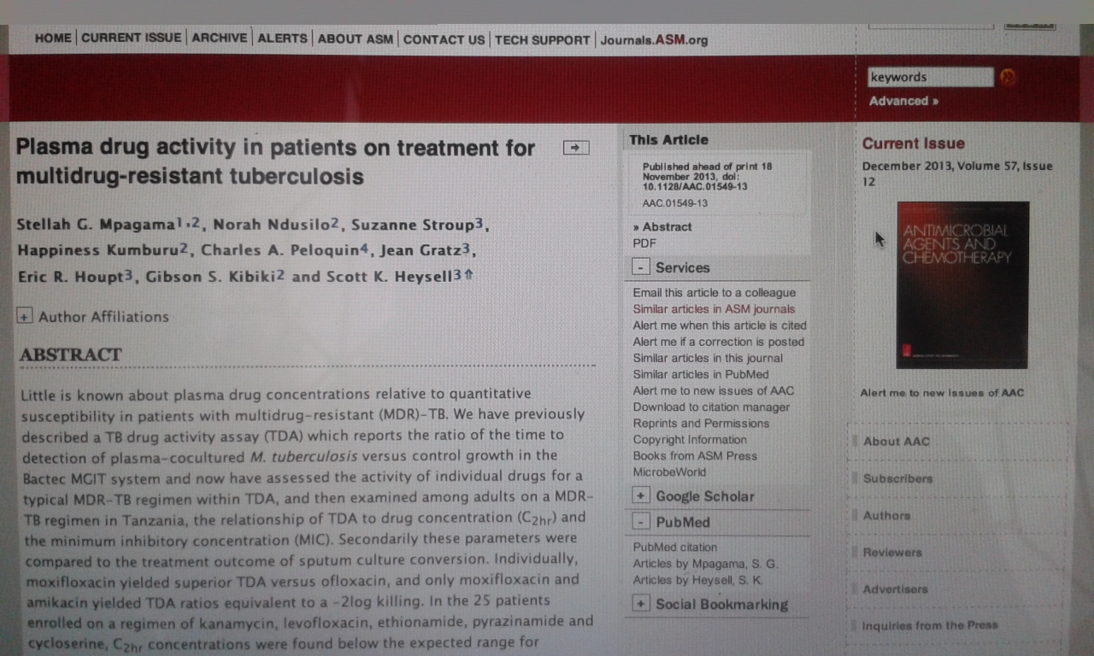

Slide 29





Acknowledgments
FUNDING AGENCIES
*FORGARTY GRANT FOR INFECTIOUS DISEASES through UVa – KCRI
*EDCTP through PanACEA
SUPERVISORS
Gibson Kibiki – KCMC, Tanzania
Eric Houpt – University of Virginia, USA
Martin Boeree – Radboud UMC, The Netherlands
TB RESEARCH TEAM- Prof Kibiki et al
KCRI – Staff
KNTH – Staff
UVa Lab staff, Prof E. Houpt et al

