Slide 1




HIV-1 pol diversity and drug resistance mutations among female bar and hotel workers in Northern Tanzania
Ireen Kiwelu
Kilimanjaro International PhD symposium
KCMC, Nov 28, 2013

Slide 2
Supervisors
  Prof. Max Essex¹
  Dr Vladmir Novitsky¹
  Prof. Saidi Kapiga ²
  Dr Rachel Manongi³
Harvard School of Public health, Boston, USA
London School of Hygiene and Tropical Medicine, London, Uk
Kilimanjaro Christian University College, Moshi, Tanzania

Slide 3
Worldwide Distribution of HIV-1 subtypes*
A1-A4
B
C
D
F1-F2
G
H
J
K
?
Type 2
HIV
Group M
Type 1
Group O
Group N
Group P
At present 58 CRFs and a large number of URFs have been described
*Santoro et al., 2013

Slide 4
HIV-1 epidemic in Tanzania
HIV-1 subtypes A1, A2, C, D, G, unique inter and intra-subtype recombinant viruses and CRF10_CD co-circulate in Tanzania (Renjifo et al., 1998; Koulniska et al., 2001; Nyombi et al., 2008; Kiwelu et al., 2012&2013)
*UNAIDS report, 2011

Slide 5
Background
The introduction of highly active antiretroviral therapy (HAART) has produced a dramatic reduction in morbidity, mortality and transmission of HIV-1 infection in developed countries as well as in resource limited countries
As access to ART rapidly increases, the prevalence of circulating drug resistant strains is also expected to increase
HIV-1 drug resistant strains have been reported in HIV-1 infected patients receiving treatment and in treatment-naïve individuals
The emergence of HIV-1 drug resistance may pose a challenge for control of HIV-1 infection since it can reduce the efficacy of the first line treatment in newly infected individuals and may impact clinical outcome
(Clavel et al., 2003)

Slide 6
Types of drug resistance mutations
Primary mutations:
  Selected under drug pressure and may lead to decrease in sensitivity to one or more antiretroviral drugs
  Not present in virus not exposed to drug pressure
Secondary mutations
  No effect on drug susceptibility
  May increase resistance or increase replication capacity in the presence of major mutations
    Polymorphisms
        Naturally occurring mutations, not selected by drugs (but can influence susceptibility)

Slide 7
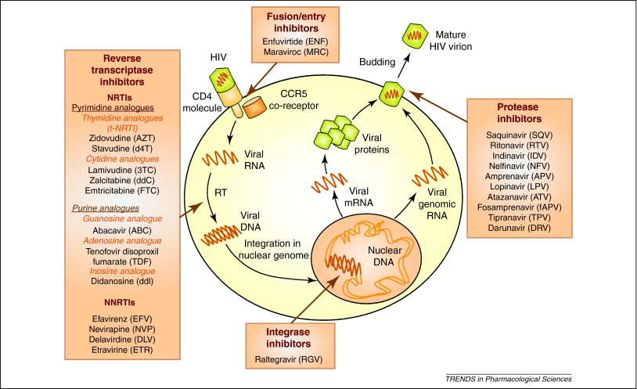
HIV-1 Life cycle and ARVs

Slide 8
Antiretroviral therapy in Tanzania
ART was introduced in Tanzania in 1995 with mono and dual regimens
Very few patients had access to ARV drugs due to the high cost
Access to ARV has increased since the Tanzanian government launched its public sector ART program free of charge in October 2004
Somi et al., 2008; Mosha et al., 2011

Slide 9
Study Rationale
Female CSW/male clients-responsible for rapid expansion of HIV/STDS in many developing countries (Mgalla et al., 1997)
Female bar/hotel workers practice part time CSW outside their working hours in order to increase their income (Kapiga et al., 2002)
  Low salary
Individuals who engage in high-risk behaviors with multiple sexual partners may play an important role in
  Transmission of HIV
  The evolution of virus as they provide an opportunity for the virus to co-infect and recombine and this poses a challenge to vaccine design and development as well as treatment
  There is little information about HIV-1 viral diversity and evolution of viruses among high-risk groups, particularly women who are working in bars and hotels.

Slide 10
HIV-1 Prevalence among Women Bar / Hotel workers in Moshi town
Study No. | Year of Sampling | Study Design | Study Population | N | HIV-1 Prevalence
1. | 2000 * | Cross-sectional study (Pilot Study) | Men and Women | 519 | 17%
 |  |  | Women | 312 | 26.3%
 |  |  | Men | 207 | 4.8%
2. | 2002 / 2005* | Prospective cohort | Women | 1050 | 19%
3. | 2004 / 2007 | Prospective cohort | Women | 800 | 17%
* Kapiga et al., 2002 ; Ao et al., 2006

Slide 11
Study rationale
Recently we reported that HIV-1 subtypes A1, C, D, inter- and intra-subtype recombinant viruses were prevalent among female bar and hotel workers in northern Tanzania (Kiwelu et al., 2012 & 2013)
Within HIV-1 group M, it has been reported that isolates of subtype D tend to be less susceptible to zidovudine, lamivudine, didanosine, nevirapine and ritonavir (Palmer et al., 1998)
It has been reported that some subtype G strains have decreased susceptibility to PIs (Vergne et al., 2000)

Slide 12
Study rationale
However, most drug-resistance mutation studies have focused on HIV-1 subtype B
Limited information is available on non-B HIV-1 subtypes, particularly in regions like Tanzania where HIV-1 multiple subtypes A1, C, D as well as a high number of unique inter- and intra-subtype recombinant viruses co-circulate
The evolution of drug-resistant mutations in the non-B HIV-1 epidemic may not necessarily follow the patterns observed in HIV-1B infection (Novitsky et al., 2007)
It is important to estimate the baseline prevalence of viral mutations and polymorphisms that might be associated with HIV-1 drug resistance in regions with HIV-1 multiple subtypes (non-B subtypes)

Slide 13
Study aims
To determine the prevalence of HIV-1 subtypes and inter-subtype recombinant viruses among female bar and hotel workers in Moshi, Tanzania
To determine the prevalence of HIV-1 drug resistance mutations among HIV-1 treatment naïve female bar and hotel workers in Moshi, Tanzania

Slide 14
Methodology

Slide 15
Study population and design
800 women aged 16-55yrs
From Dec 2004 to Mar 2007
Followed quarterly-1year
Interviewed
Blood samples were
Collected for HIV-1 testing
139 (17%)
HIV-1 positive
Blood and genital
Samples collected
For HIV-1 genotyping
50 women
Provided samples in all five time points

Slide 16
Laboratory methods
A subset of 50 samples collected at early time point from treatment naïve female bar and hotel workers (enrollment) was selected for this study
Samples collected in 2005
A fragment of the HIV-1 pol gene encoding entire protease and reverse transcriptase was amplified by SGA/S technique
HIV-1Subtype determination
  Phylogenetic tree analysis – Neighbor-Joining method, Kimura 2-parameter
Recombinant virus determination: RIP and Simplot analysis

Slide 17
Drug resistance mutations analysis
PR and RT drug resistance associated mutations and polyphophisms were analyzed and interpreted by using:
  International society –USA (IAS-USA) major mutation list (Johnson et al., 2013)- sequences were translated to amino acids and manually inspected for drug resistance mutations for PR and RT
  Stanford University HIV-1 drug resistance database (http://hivdb6.stanford.edu)

Slide 18
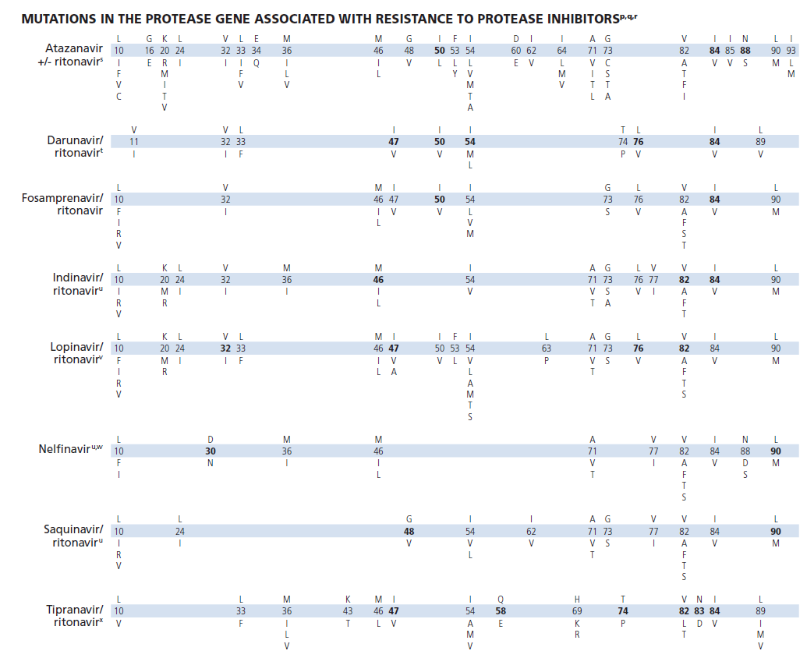
International society –USA (IAS-USA) mutations list -PIs
36 amino acids positions
Johnson et al., 2013

Slide 19
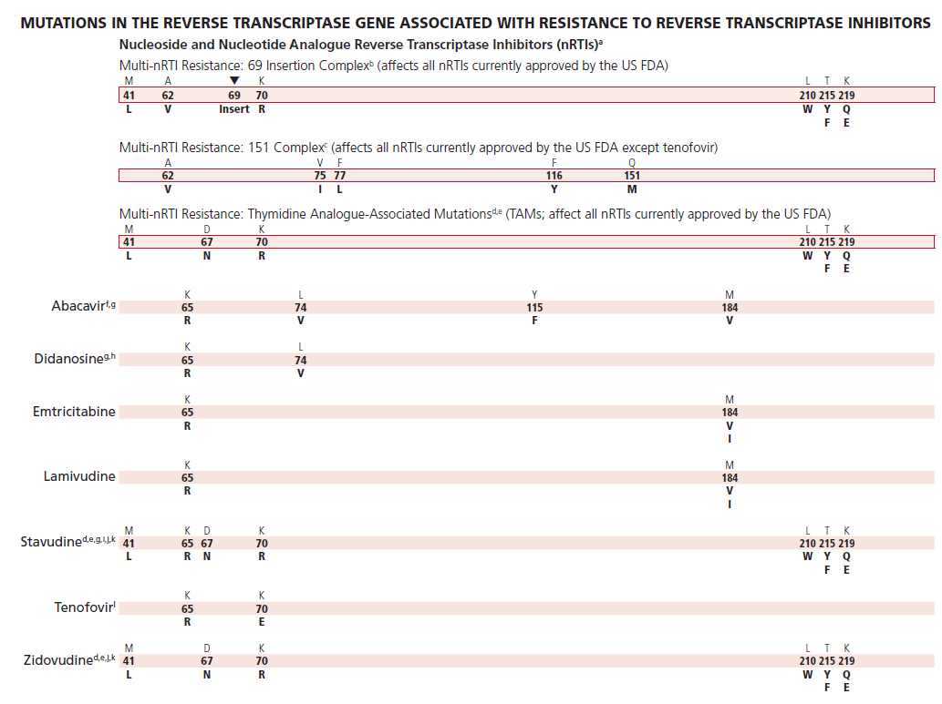
International society –USA (IAS-USA) major mutation list -NRTIs
16 amino acid positions
Johnson et al., 2013

Slide 20
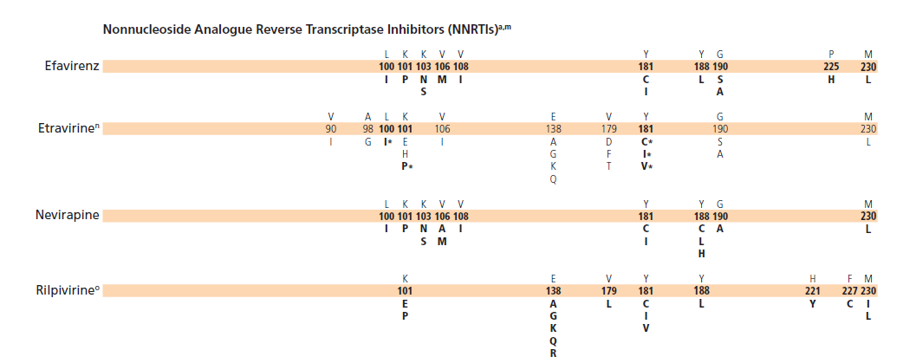
International society –USA (IAS-USA) major mutation list -NNRTIs
16 amino acid positions
Johnson et al., 2013

Slide 21
RESULTS

Slide 22
Distribution of HIV-1 subtypes based on pol gene among female bar and hotel workers in Moshi, Kilimanjaro, Tanzania in 2005.
Subtype | V1-C5 env gene* | pol gene (PR and RT) | env*/pol genes combination
A1 | 24 (53.3%) | 16(35.5%) | 16 (35.5%)
C | 14 (31.1%) | 13 (28.8%) | 11(24.4%)
D | 3 (6.6%) | 4 (8.8%) | 2 (4.4%)
Recombinant | 4 (8.8%) | 12 (26.6%) | 16(35.5%)
Total | 45 | 45 | 45
Phylogenetic analysis of both env and pol indicated that subtype A(35.5%), C (24.4%), D (4.4%) and Recombinant viruses (32.6%).
Pol gene has a higher 26.6% of Rec as compared to env gene 8.8%
*Kiwelu et al., 2012

Slide 23
HIV-1 inter-subtype recombinant viruses and multiple infections
Subject code | V1-C5 env gene (Kiwelu et al., 2012) | PR and RT (pol gene)
33 | D/A1 | D/A1/D
87 | A1 | C/A1
177* | A1 | A1
 |  | A1/C/A1
209* | A1 | A1
 |  | A1/U*/A1
 |  | C/U*/A1
322* | A1 | C
 | A1/C/A1 | C/A1
355 | A1 | U*/D/U*
471 | C/A1 | C
491* | A1 | A1
 |  | C
 |  | D/A1/D
510 | D/U*, | D
 | D/U*/D
558 | C | A1/C
603* | C | A1
 |  | A1/C
697 | A1 | C
740 | A1 | D
733 | D | CRF35_AD/A1/CRF35_AD
838 | C | CRF10_CD/C/CRF10_CD
909 | A1 | A2/C/A2
Total Recombinants | 4 (8.6%) | 12 (26.6%)
*HIV-1 multiple infections : * unclassified region

Slide 25
CRF35_AD/A/CRF35_AD

Slide 26
Major mutations associated with Protease inhibitors
Subject code | HIV-1 subtype | Total No of quasispeciess | Major Mutations | No of quasispecies with mutation
276 | C | 10 | M46I | 1
480 | A1 | 32 | M46I | 1
733 | CRF35_AD/A/CRF35_AD | 40 | M41L | 1
Note: All subjects in this study harbored three or more polymorphisms at amino acid positions (16, 20, 34, 36, 60, 62, 63, 64, 69, 71, 74, 77, 89, 90 and 93) associated with PI’s in HIV-1 subtype B.

Slide 27
Secondary mutations at positions associated with PIs according to HIV-1 subtype A and C in comparison with treatment naïve individuals from Stanford HIV drug resistance database
Subtype A p= 0.161
Subtype C p= 0.104
polymorphisms are not associated with the PI drug resistance mutations

Slide 28
Mutations and polymorphisms at positions associated with NRTIs
Subject code | HIV-1 subtype | Total No of quasispecies | Mutations (NRTI) | No of quasispecies with mutation
 |  |  | Primary mutation
245 | A1 | 22 | D67N | 1
201 | C | 13 | K65R | 1
 |  |  | Polymorphisms
740 | D |  | M41I | 1
66 | C | 13 | T69A | 1
245 | A1 | 22 | T69P | 1
209 | A1 | 24 | V75A | 1
909 | A2/C/A2 | 21 | V75A | 1
46 | A1 | 24 | T215A | 1
D67N is thymidine analogue-associated mutations which contribute resistance to zidovudine (AZT) and stavudine (d4T)
K65R- resistance to Lamivudine, stavudine and tenoforvir

Slide 29
Primary and secondary Mutations as well as polymorphisms at positions associated with NNRTIs
Subject code | HIV-1 subtype | Total No of quasispecies | Mutations (NNRTI) | No of quasispecies with mutation
 |  |  | Primary mutation
201 | C | 13 | Y181C | 1
491 | C | 45 | V106M | 4
 |  |  | Secondary mutation
168 | A1 | 19 | V90I | 1
838 | CRF10_CD/C/CRF10_CD | 18 | V90I | 2
905 | A1 | 16 | V90I | 9
 |  |  | E139K | 1
237 | A1 | 13 | E138A | 5
291 | C | 32 | E138A | 2
 |  |  | Polymorphisms
237 | A1 | 13 | A98S | 6
 |  |  | L101Q | 1
480 | A1 | 32 | G190E | 1
V106M is common in subtype C and resistance to nevirapine and efavirenz
Y181C resistance to all NNRTIs

Slide 30
Summary of results

Slide 31
Summary
The most prevalent HIV-1 subtype in this population was subtype A (35.5%), followed by subtype C (28.8%) and then HIV-1 inter-subtype recombinant viruses (26.6%). HIV-1 subtype D was less prevalent
    Subtype A is still stable
    Subtype C (30%) is increasing as compared to the pilot study (23%)
    Subtype D is decreasing (4%)as compared to the previous studies (11.3%)
    The percentage of inter-subtype recombinant viruses was higher (26.6%) than in the previous study (8.6%)(Kiwelu et al., 2012)
    Previous studies have shown that pol gene appears to be a hot spot of recombination (Robertson et al., 1999;Jetzt et al., 2000; )

Slide 32
Summary
  CRF35_AD/A/CRF35_AD was identified for the first time in this population. CRF35_AD complex recombinant is a new genetic recombinant not only in Moshi but also in Tanzania
  The prevalence of multiple infections was 15% in this population

Slide 33
Summary
The prevalence of HIV-1 drug resistance mutations (PIs and RTIs) in this population was 13%
HIV-1 drug resistance mutations to RT inhibitors existed in this population possibly due to suboptimal regimens and poor adherence before the ARV were widely used in Tanzania
It is possible that resistance strains associated with RTIs may be acquired sexually from HIV-1 infected patients receiving treatment

Slide 34
Summary
Although we have reported three subjects (7%) with major mutations associated with PI, protease inhibitors were not used in Tanzania at the time of sample collection
It is therefore possible that the M46I andM46L might occur as natural polymorphism or the resistance strains may be acquired sexually from HIV-1 infected patients receiving treatment (Bennett et al., 2009)
Further studies will be required to gain a better understanding of the clinical and biological implications of the natural polymorphisms at positions associated with drug resistance to PIs and RTIs in non-B HIV-1 subtypes, including the significance of recombinant viruses with the increasing use of ARV drugs

Slide 35
Conclusion
HIV-1 epidemic in this population is highly diverse with multiple HIV-1 infections and unique HIV-1 inter-subtype recombinants as well as complex circulating recombinant forms
This study provided baseline prevalence of HIV-1 drug resistance mutations and natural polymorphisms at amino acid positions associated with HIV-1 drug resistance to NRTIs, NNRTIs and PIs before the ARV drugs were widely used in Tanzania
  Multiple infections and recombination significantly add to the genetic diversity of HIV-1 which may have important implications for vaccine design and development, diagnosis and antiretroviral therapy

Slide 36
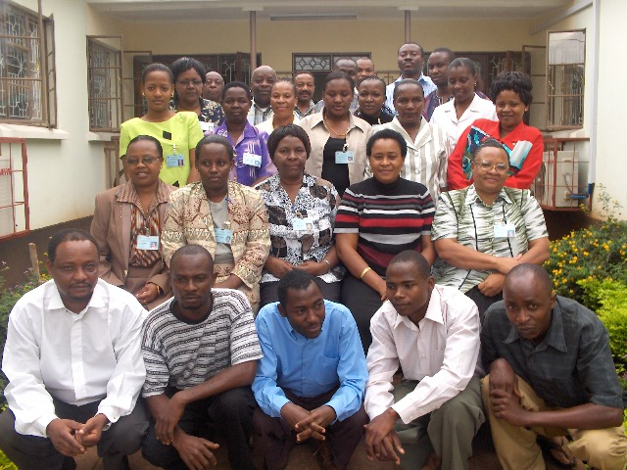
Acknowledgements
HSPH-Essex Lab
  Max Essex
  Vladimir Novitsky
  Mary Fran McLane
  Lauren Margolin
  Jeannie Baca
  Chris Rowley
  Iain MacLeod
  Washington Ochieng
  Melissa Zahralban
  David Tim
  Mamadon Diallo
  Kate Reimer
  Tun Hou Lee
  Beth Chaplin
KCMC and KCMUCo
M. Ntabaye
E. Kessi
KCMC- KRHP Tanzania
  John Shao
  Saidi Kapiga
  Watokyo Nkya
  Noel Sam
  Rachel Manongi
  Uzo Ndibe
Sponsors
KCMC Good Samaritan Foundation (GSF)
International Partnership for Microbicides (IPM)
International Fogarty Fellowship
Moshi Research Team
Thank you Study Participants

Slide 37
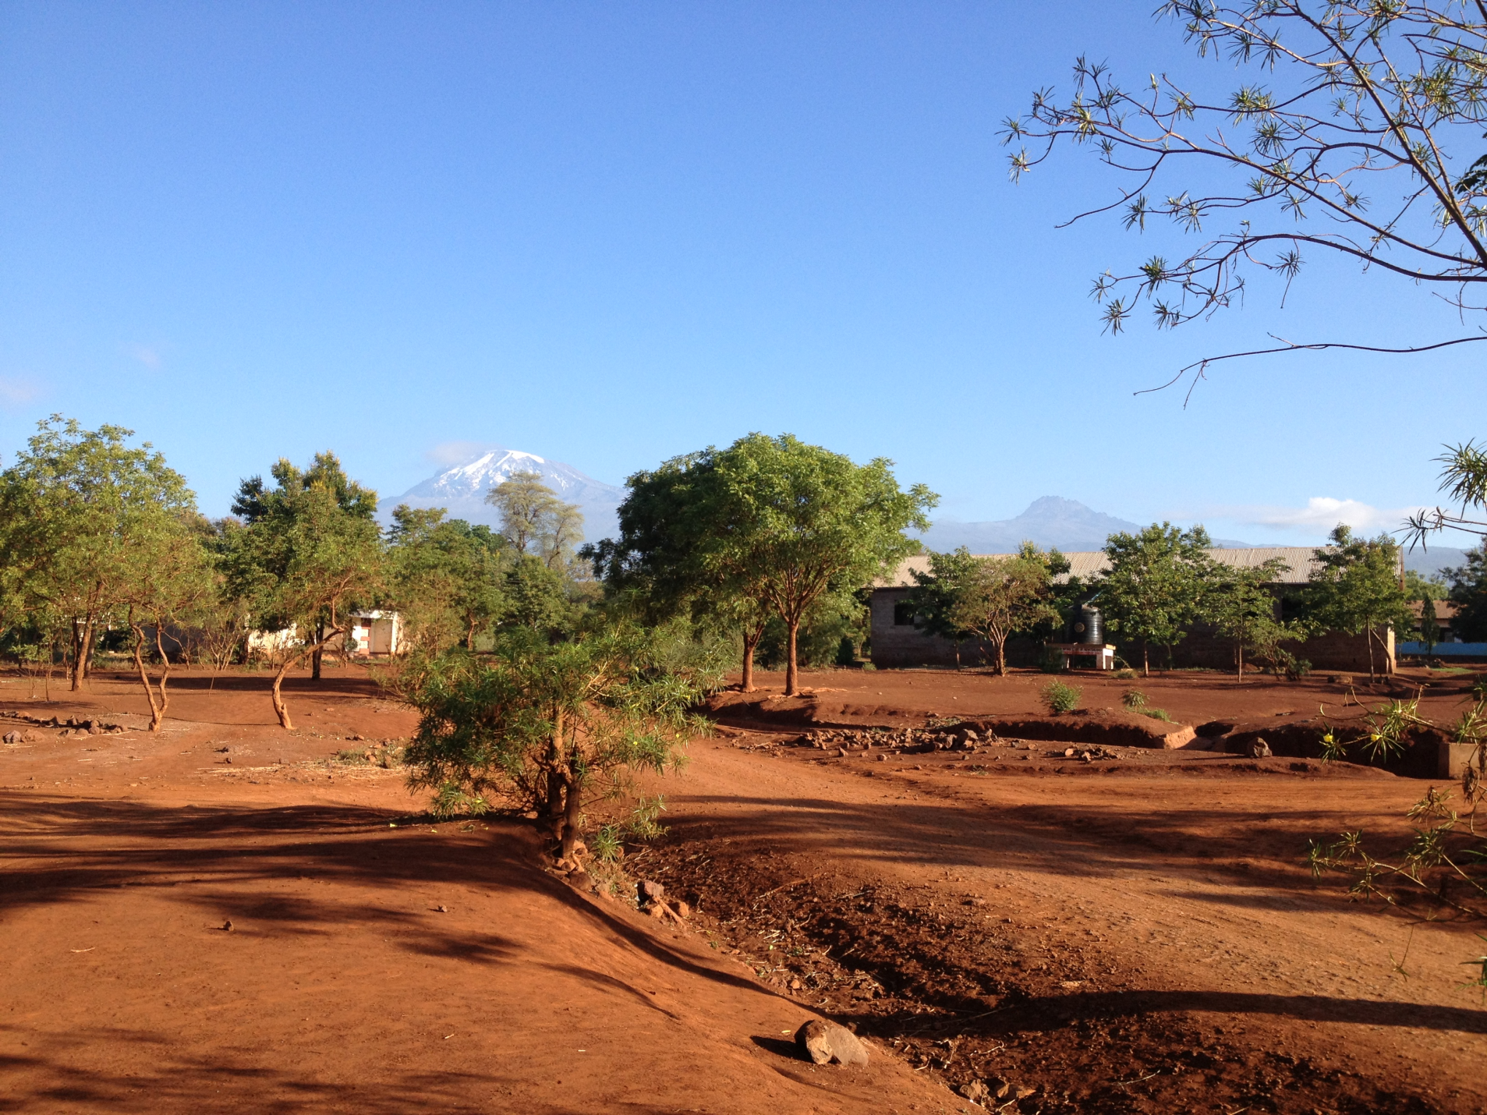
Thank you!!!
Questions???

