Slide 1
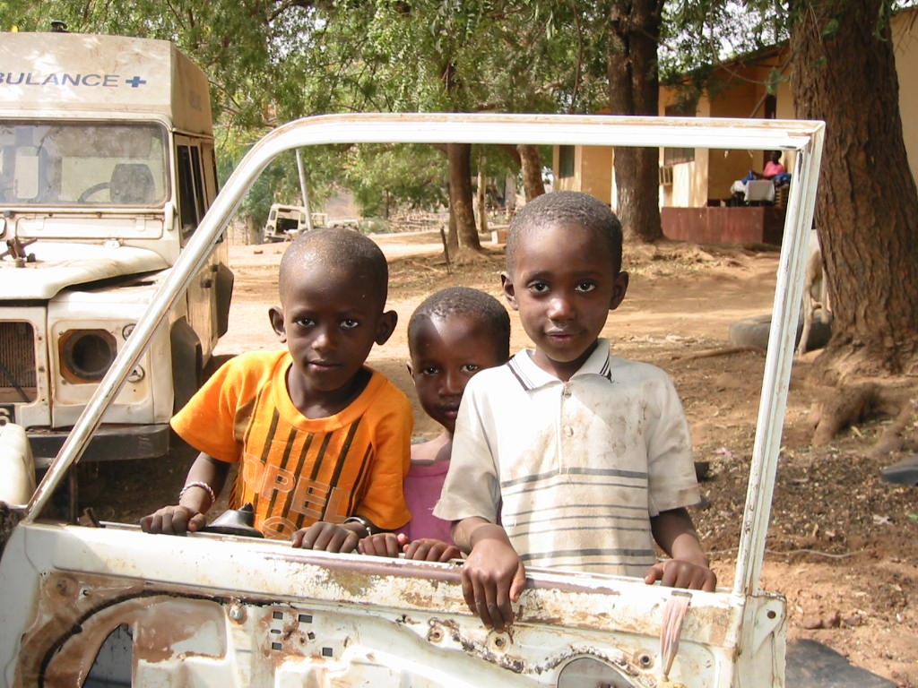
2nd Kilimanjaro International PhD Symposium
Kicking off a discussion on the initial stages of the proposal writing process
Peter Furu
Copenhagen School of Global Health
Department of International Health,
Immunology and Microbiology
University of Copenhagen
KCMC, Moshi
27-29 November 2013

Slide 2
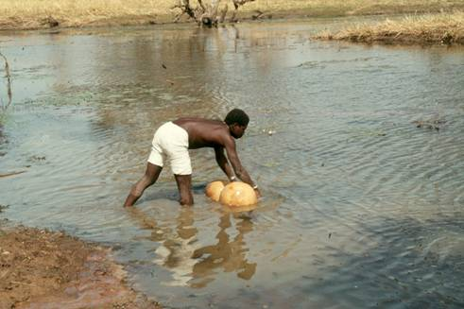
What to expect in this session ?
A brief discussion on some of the initial proposal development steps
Research problem analysis
Stakeholder analysis

Slide 3
Before writing the proposal
What is a research problem ?
“A research problem is the problem or issue that leads to the need for a study”
Creswell, 2008
“Defining a research problem is the fuel that drives the scientific process and is the foundation of any research method and experimental design from true experiment to case study”
Shuttleworth, 2008

Slide 4
Before writing the proposal
Problem analysis
“When research is applied or operational it may be applicable to do conduct a problem analysis
Problem analysis
Justify the importance of the problem through a proper state-of-the-art literature review
Problem statement

Slide 5
Before writing the proposal
Problem analysis
“When research is applied or operational it may be applicable to do conduct a problem analysis
Problem analysis
Justify the importance of the problem through a proper state-of-the-art literature review
Problem statement

Slide 6
Before writing the proposal
Problem analysis
Identify core problem
Identify factors and their interactions with the problem
Problem
Factor
Factor
Factor

Slide 7
Before writing the proposal
Problem analysis
Reflection !
Who are involved in problem identification and analysis ?

Slide 8
Before writing the proposal
Problem analysis
What is the problem ?
What are the factors ?
Taking a Logical Framework Approach (LFA)

Slide 9
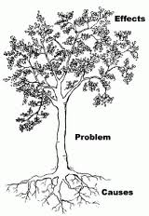
Before writing the proposal
Example
Problem analysis
Effects
Problem
High infant mortality
Frequent use of infected river water
Unstable supply of piped water
Causes
Frequent pump breakdowns
Source: Danida. 1996.

Slide 10
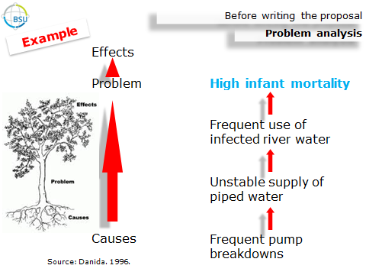
Before writing the proposal
Problem analysis
Knowing the problem and potential factors
- you will next translate problems into objectives for the project

Slide 11
Before writing the proposal
Example
Problem analysis
Increased environmental health burden of water related diseases in Southern Africa

Slide 12
Climate change/variability
Increased rainfall
Inadequate health infrastructure and capacity
Poor accessibility to health services
Increased temperatures
Increased drought and water scarcity
Low disaster preparedness
Increased vector-breeding potential
Insufficient training of health work force
Increased flooding
Increased environmental pollution
Insufficient sanitation facilities
Poor drainage systems
Unstable drug delivery
Weak health education
Weak legislation and enforcement
Contamination of drinking water
Increased environmental health burden of water related diseases in Southern Africa
Poor governance
High illiteracy
Loss of medicinal plants
Gender imbalances
Decreased air quality
Inappropriate cultural beliefs and practices
Degradation of biodiversity
Poor waste disposal systems
Lack of prior community consultations/involvement
Poor knowledge on hygiene
Excessive use of agro-chemicals
Haphazard industrial development
Poor immune status
Increased food shortages
Poverty
Unreliable environmental impact assessments
Poor nutritional status
Economic decline
Weak policies

Slide 13
Before writing the proposal
Problem analysis
Categories (1)
Climate change/variability
Increased temperatures
Increased rainfall
Increased flooding
Environmental
Degradation of biodiversity
Loss of medicinal plants
Insufficient sanitation facilities
Decreased air quality
Increased vector breeding potential
Increased environmental pollution
Poor drainage systems
Excessive use of agrochemicals
Contamination of drinking water
Re-grouping factors into broad categories

Slide 14
Before writing the proposal
Problem analysis
Categories (2)
Governance/institutional
Haphazard industrial development
Unreliable environmental impact assessments
Inadequate health infrastructure and capacity
Insufficient raining of health workforce
Weak health education
Poor accessibility to health services
Weak policies (health, water, environment)
Weak waste disposal systems
Unstable drug delivery
Low disaster preparedness
Lack of prior consultations/involvement
Weak legislation and enforcement

Slide 15
Before writing the proposal
Problem analysis
Categories (3)
Socio-economic
Poverty
High illiteracy
Gender imbalance
Increased food shortages
Biological
Poor immune status
Poor nutritional status
Behavioral
Inappropriate cultural beliefs and practices
Poor knowledge on hygiene behaviour

Slide 16
Before writing the proposal
Conceptual framework
Climate change/variability
Poor governance
Poverty/socio-economy
Rural and urban development
Environmental degradation and pollution
Inadequate health infrastructure and capacity
Flooding
Water scarcity
Poor immune and nutritional status
Contamination of water
Increased vector-breeding potential
Poor sanitation and hygiene
Lack of community awareness
Vulnerable communities
Increased environmental health burden of water related diseases in Southern Africa

Slide 17
Before writing the proposal
Problem analysis
Finally !
Decide on scope and final research focus

Slide 18
Writing the proposal
Problem statement
Eventually the formulation of a problem statement should reflect the context and focus of the chosen research area and at the same time state the significance and justification of the project
It will provide a frame for the expected results, conclusions and possible recommendations

Slide 19
Before writing the proposal
Stakeholder analysis
Reflection !
What is a stakeholder in the context of research ?
“Stakeholders can be organisations, groups, departments, structures, networks or individuals and who has something to gain or lose through the outcomes of a planning process or project”
www.odi.org.uk

Slide 20
Before writing the proposal
Stakeholder analysis
seeks to answer questions like:
Who depends on the project?
Who are interested in the outcome of the project?
Who will influence the project?
Who will be affected by the project?
Who will work against the project?
Source: Danida. 1996. Logical Framework Approach. A flexible tool for participatory development

Slide 21
Before writing the proposal
Stakeholder analysis
High
Organization of stakeholders in matrices
Engage closely and influence actively
Keep satisfied
“Influence map”
Power
Monitor (minimum effort)
Keep informed
Low
Low
Interest
High
www.odi.org.uk

Slide 22
Before writing the proposal
Stakeholder analysis
The stakeholder mapping and analysis are also of important value when developing the project dissemination strategy
WHY ?
- - will help in deciding on priority targets and project efforts in research communication

Slide 23
Writing the proposal
Focus has been on some important pre-proposal writing activities
Then follows ?
Translating the conceptual framework, problem statement and literature review into research questions and possibly research hypotheses

Slide 24
Thank you very much !
And here a hand-over to the next contributor for a presentation of other aspects of proposal development

