Slide 1
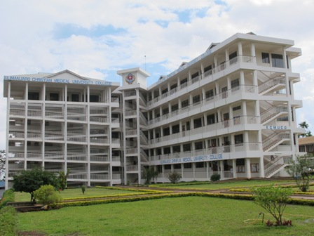
PhD Programme at KCMUCo
Dr Declare Mushi, Ag. DPS

Slide 2
KCMUCo: Vision and Mission
Vision statement
The vision of the KCMU Co is to be a centre of excellence in teaching, research and development of health professionals who influence society through dignified health care delivery to promote the love and compassion of Christ.
Mission statement
The Mission of the College is teaching, research and healing in order to
proclaim Christ, in the sense that:
we are called to serve by teaching so that people can see the light
through healing services, the people of Tanzania can be set free from bondage of disease and spiritual sickness.
by creating knowledge through research, the people of Tanzania can be masters of their physical environment and overcome poverty.

Slide 3
Non-discriminatory policy
KCMU Co believes in equal opportunity and does not discriminate against any student or prospective student, employee or prospective employee on the basis of race, sex, ancestry, national origin, age, disability, or religion.

Slide 4
Overall aim
PhD degree students are prepared to assume academic or research careers in basic or applied science related to clinical, public health or careers in public health practice within both the public and private sectors

Slide 5
Structure & Organization of PhD program
PhD training is under the Directorate of Postgraduate Studies
PhD students are placed in various centres Eg. Research in situations, Hospitals, Community, NGOs etc
Registration is any time of the year
PhD Training is 3-4 years

Slide 6
Admission
BSc/MD – Master path: (Minimum pass at B+)
MD – PhD path:
Highly motivated and qualified students are allowed to proceed from MD directly to PhD
MD score B and above
Dissertation B+
Publication Experience
Pass obligatory Foundation courses
Employee of KCMUCo/KCMC

Slide 7
To graduate
Attend courses- decided by the supervisors and the DPS
3 or more published papers (different Journals)
Thesis book (bound or printed book)
(Currently under review as per TCU- UQF=
Re quirement- 540 credit points)

Slide 8
Application procedure
Fill application forms- any time
Submit a concept proposal (15 pages)
Phase 1: Provisional admission - (6 months to 1 year) to develop full proposal
Phase 2: Full admission after ethical approval

Slide 9
Defense
PhD defence session at KCMU College is open to interested academicians and non-academicians
Presentation -maximum of 25 minutes
Questions & Answers- Maximum 2hrs

Slide 10
PhD Platform- student network
Aim
Opportunity for PhD students to exchange ideas and discuss matters related to their research and academic work through hosting of forums, seminars and conference and informal discussions

Slide 11
PhD Enrolment Female 40%
 | 2005/ 2006 | 2006/ 2007 | 2007/ 2008 | 2008/ 2009 | 2009/ 2010 | 2010/ 2011 | 2011/ 2012 | 2012/ 2013 | 2013/ 2014 | TOTAL
Male | - | - | - | - | 04 | 01 | - | - | 06 | 08
Female | - | 01 | - | 01 | 01 | 04 | - | 02 | 05 | 12
Total | - | - | - | 01 | 05 | 05 | - | 02 | 11 | 25

Slide 12
PhD Graduates
 |  | 2005 | 2006 | 2007 | 2008 | 2009 | 2010 | 2011 | 2012 | TOTAL
 | Male | - | - | 01 | - | - | - | 01 | 01 | 03
 | Female | 01 | - | - | - | - | 01 | - | - | 02
 | TOTAL | 01 |  | 01 |  |  | 01 | 01 | 01 | 05

Slide 13
KCMC/KCMUCo Staff on PhD training Abroad
Male: 3
Female: 3

Slide 14
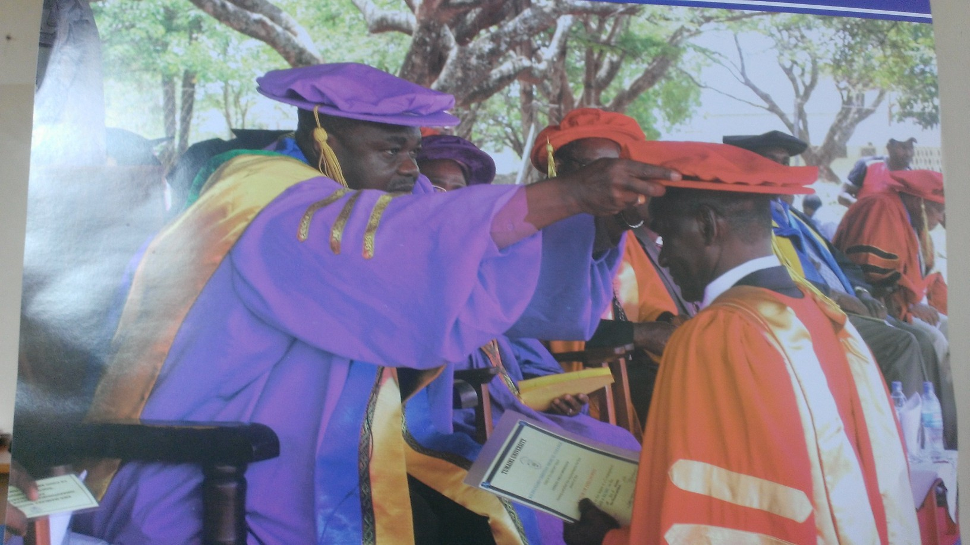
FINALLY YOU ARE THERE! “WHAT MATTERS IS WHAT YOU CAN DELIVER AFTERWARDS”

Slide 15
”It is better to deserve honors and not have them than to have them and not to deserve them.” - Mark Twain
THANK YOU

Slide 16
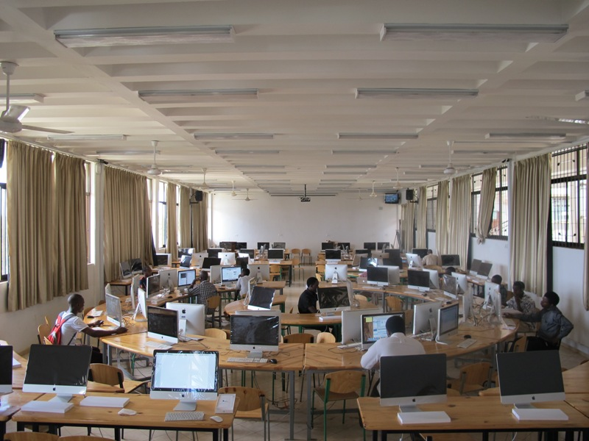
THANK YOU

