Slide 1
Validating the Applicability of Malaria Rapid Diagnostic Tests and Next Generation Sequencing as Platform Elements in Molecular Surveillance of P. falciparum Malaria Epidemiology and Epidemic Risks
The 2nd Kilimanjaro International PhD symposium
November 27th-29th 2013
Sidsel Nag
Center for Medical Parasitology
University of Copenhagen

Slide 2
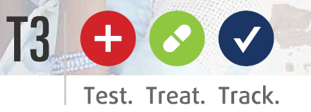
WHO guidelines
Test: Malaria rapid diagnostic test (RDTs):
Malaria cases confirmed prior to treatment | 2005 | 2011
Globally | 68 % | 77 %
WHO Africa region | 20 % | 47 %
According to WHO Malaria Report 2012
Treat: Artemisinin combination therapies (ACTs):
Efficacy = >95 % in SSA
Track: ….
Notes:
The T3 initiative is founded upon WHO guidelines within all three areas. As for diagnostically testing for malaria, in 2010 WHO changed their policy from “Treat all suspected cases of malaria” to “Test all suspected cases of malaria and treat all confirmed cases of all malaria”. The RDTs were properly “really” implemented around the same time, and there’s been a very positive development on this area (Table). As for malaria treatment, ACTs remain highly effective in SSA and still represent the recommended treatment almost globally. As for surveillance of malaria, WHO has also set up guidelines for countries in the control phase and for countries in the elimination phase, but surveillance systems are not abundant in SSA, and the guidelines may therefore prove slightly difficult to follow…

Slide 3
WHO Malaria Report 2012
Guidelines for Malaria surveillance
Countries in control phase
Identify hotspots and hotpops for targeted intervention
Identify trends (epidemics, decreasing malaria or lack thereof…)
Assess if control measures are effective
Countries in elimination phase
Detect all malaria cases
Reactive case detection (assess the geographical origin of the infection)
Focus on local areas with transmission

Slide 4
WHO Malaria Report 2012
Estimates from WHO 2012
Only ~10 % of all malaria cases globally are reported
41 out of 99 countries were unable to submit sufficient data in 2011 to evaluate malaria trends
41 out of 99 countries are estimated to represent 85 % of global malaria burden
Notes:
One of the many things illustrated in the Malaria Report from WHO 2012, was the lack of surveillance systems. Together with information regarding the prospects for control and elimination for each WHO region, this figures also shows how many countries were unable to submit data consistent enough with previous data or sufficient enough, to assess the malaria trends for the country. They also assessed the underlying reasons, and for the African countries unable to submit data, they argue that they quite simply don’t see enough of the malaria patients at the health facilities. Only a small fraction seek help, and therefore their data are not recorded. So in regard to the guidelines for surveillance, the facts are as follows (see facts).

Slide 5
Molecular surveillance
Transmission data
Human serum, antibodies
Parasite genetics
Resistance markers
Evolutionary trends
Geographical mapping of parasite haplotypes
Notes:
What do I mean by molecular surveillance? It’s not a terminology I made up, but it is sparsely used and it does sound a little bit like a catchy term with no real meaning.
What I’m referring to is basically;
detecting the parasite at the molecular level (so not necessarily sick malaria patients who are diagnosed with malaria). If transmission is occurring, the host is bound to react to it: symptoms or no symptoms. Antibodies→ Transmission data.
Analysing the parasite at the molecular level – and yes, there a TON of molecular elements one could choose to survey at the molecular level. We’re going to focus on parasite genetics, to establish various things:
-Prevalence of resistance markers: P. falciparum has shown to be very capable of developing resistance towards the applied antimalarial drugs. For various reasons, all established resistance markers are worth monitoring.
-Evolutionary trends: how is the parasite evolving? This has partly to do with things such as resistance markers, but it basicly has to do with any malaria trend observed. Any kind of adaptation or selection will be of interest to the health community and not least to those creating guidelines.
-Lastly, the inevitable geographical mapping. Hopefully, the malaria burden will continue to decrease everywhere in the world. This will lead to a situation where some countries will experience having “eliminated” malaria, but it’s neighbouring countries won’t. Malaria patients here require the socalled reactive case control: where did they get the infection?? But most interestingly… perhaps geographical mapping can be done within a country, and not only within a continent?

Slide 6
Malaria Rapid Diagnostic Tests (RDTs)
Antibodies for transmission data
Resistance markers
Optimizing non-targeted sequencing based on DNA material extracted from RDTs
Notes:
This is the malaria Rapid diagnostic test. In essence, this test, when it has been used to diagnose a malaria patient with malaria, contains all the elements necessary for analysis of the molecular epidemiology of malaria.
It contains host serum, it contains host DNA and most importantly, it contains parasite DNA if the test is positive.
However, the droplet size of the blood, is no more than approximately 10-25 ul, which doesn’t leave a lot of material for further analysis. Second of all, it’s very unprecise, volumewise, and therefore the data from RDTs will require other measures if we have to compare them or analyse them in batches or pools. Not least: the droplet is dried on filterpaper. Now, filterpaper has been used for quite some time for acquiring samples in the field. A dried piece of filterpaper is just easier to deal with, than an EDTA tube and so is the dried blood with regards to storage. Therefore, it is even more so, relevant to collect these RDTs, because the filterpaper samples that researches travel a long way and put a lot of resources into collecting, are essentially available at the healthcare centers applying RDTs. However – the maximum applicability of these tests has not been proven, and we would like to take the challenge!

Slide 7
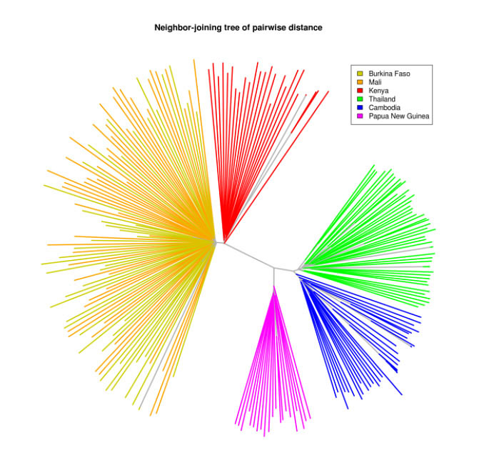
Next generation sequencing (NGS)
Kenya
From Science, June 13th 2012
Analysis of Plasmodium falciparum diversity in natural infections by deep sequencing.
Magnus Manske et al.
Differences in diversity?
Detectable evolutionary trends?
Genetic diversity of P. falciparum from chosen areas
Can mapping be done on a regional level??
Evolutionary development of P. falciparum from chosen locations across malaria seasons
→ What role does transmission intensity and transmission fluctuations play?
Transmission
intensity
Thailand
Burkina Faso and Mali
Time
Cambodia
Papua New Guinea

Slide 8
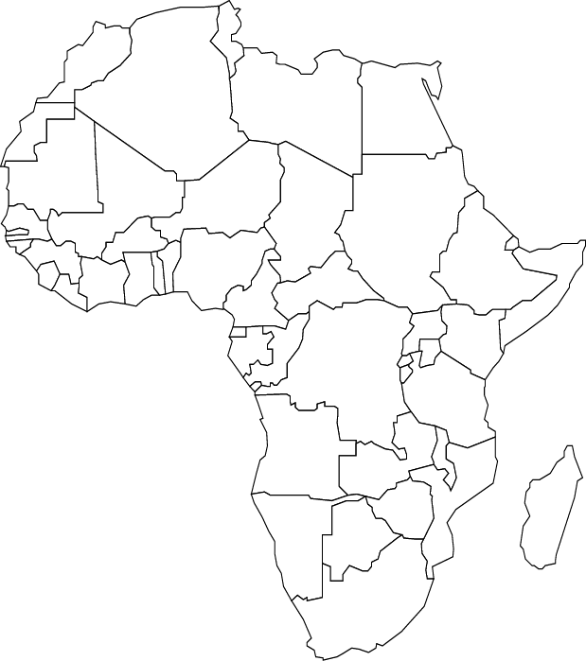
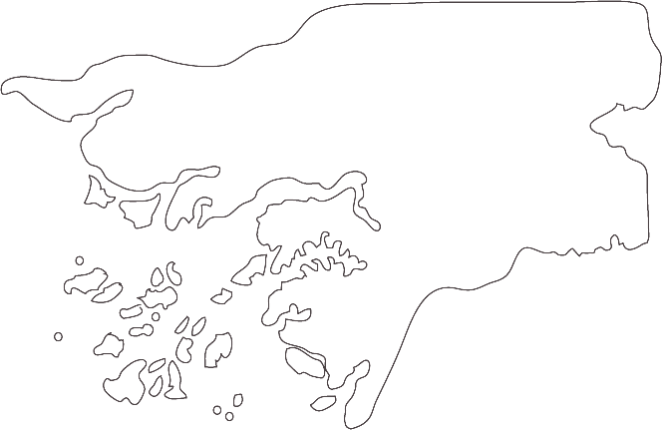
Sampling sites (tentative)
Guinea-Bissau
Tanzania
Mwanza
Magu
Cacheu
Gabu
Misungwi
Sengerema
Tanga
Bandim
Magoda
Mukuzi
Korogwe
Teule

Slide 9
Sampling procedures (tentative)
RDTs
Febrile patient
All study sites
All used RDTs
Monthly basis
18 months
Diagnosis
RDT dries
Storage
Strips are packed individually
Collection
Copenhagen

Slide 10
Sampling procedures (tentative)
Blood samples
Positive malaria diagnosis
Only major study sites (one from each area)
100 infections per season (high and low if applicable)
18 months
Blood sample
Centrifugation
Separation of buffy coat
Storage
Copenhagen

Slide 11
Objective: Concept development
Maximum RDT potential
Applicable NGS data
Sampling, storage procedures
Cost-effective methodology
Evolutionary insight → relevant for approaches for control and elimination
Diversity, mapping
Geographical mapping based on barcoding?
Whole-genome sequencing based on RDTs?

Slide 12
Data sharing
Open access data, as real time as possible
Drugresistancemaps.org
PlasmoDB (and others)

Slide 13
Acknowledgements
Collaborators:
Bandim Health Project
Guinea Bissau Amabelia Rodriguez
NIMR Mwanza and Tanga Alphaxard Manjurano and
Tanzania Deus Ishengoma

Slide 14
Acknowledgements
Supervisors
Principal supervisor: Michael Alifrangis
University of Copenhagen
Co-supervisors: Ole Lund and Frank Møller Aarestrup Technical University of Denmark
Poul-Erik Kofoed
University of Southern Denmark
Johan Ursing
Karolinska Institute, Stockholm

Slide 15
Thank you for listening
Ideas, collaboration, criticism: we would appreciate all of it
If you have any samples you would like us to sequence, don’t hesitate to ask!!
sidselnag@sund.ku.dk

