Slide 1
Utilizing nanobody technology to target non-immunodominant domains of
VAR2CSA
Sisse B. Ditlev
Centre for Medical Parasitology
University of Copenhagen

Slide 2
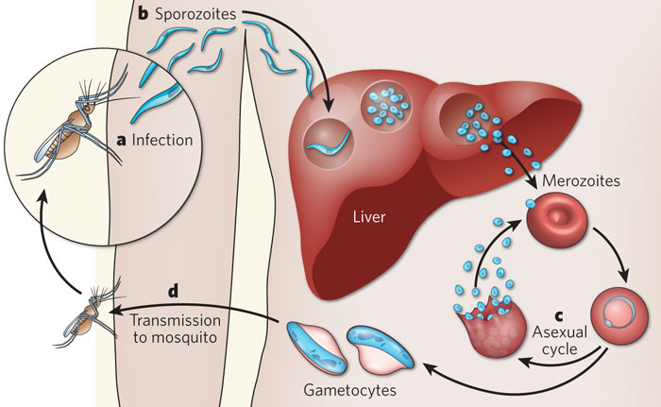
P. falciparum

Slide 3
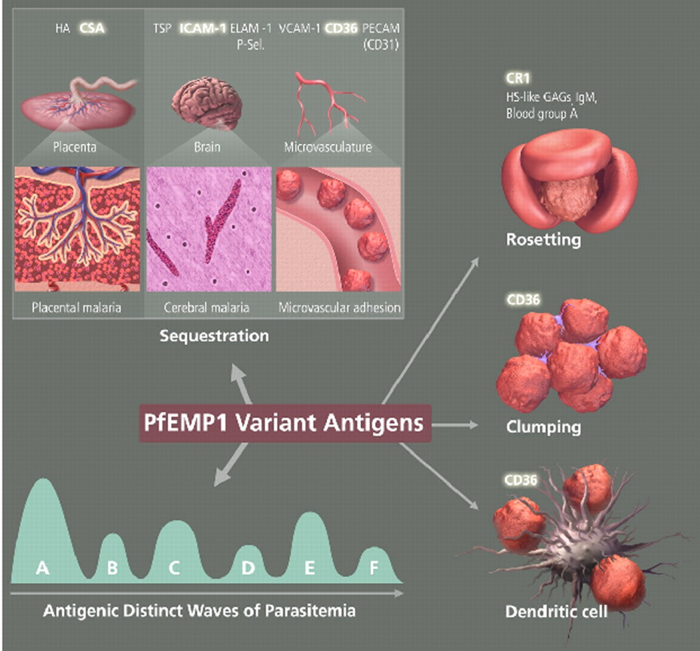
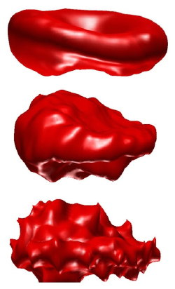
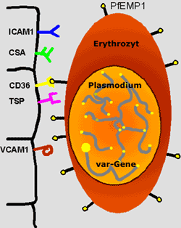
P. falciparum Erythrocyte Membrane Protein 1
  P. falciparum infected RBC change morphology
  Express PfEMP1 on
  the surface
Filtered by the spleen,
if it wasn’t for…
  Encoded by var genes (~60)
  Mutually exclusive expression
PfEMP1 is central in both pathogenesis and immunity
Notes:
PfEMP1 is central in both pathogenesis and immunity
The malarial parasite modifies the erythrocyte by exporting proteins into the host cell.
One such modification is the expression of PfEMP1 on the erythrocyte surface which functions as the cytoadherent ligand.
The binding of this ligand to receptors on host endothelial cells promotes sequestration and allows the infected erythrocyte to avoid the spleen

Slide 4
Placental Malaria
Incidens
Parasitaemia
During pregnancy women are again at risk
Immunity to this malaria-form is also acquired as a funtion of gravidities
Disease
Deaths
5
10
15
20
25
50
Age (years)
Modified from BM Greenwood et al.

Slide 5
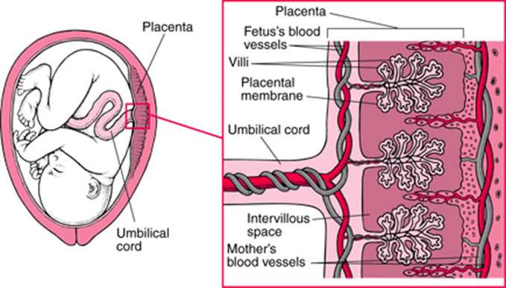
Placental Malaria
Accumulation of iRBC leads to
inflammation in the placenta
IRBC in the intervillous space
1/3 of preventable low
birth weight babies
Premature labour
Spontaneous abortion
Stillbirth
Maternal anaemia
PM is often asymptomatic
-> will not be treated

Slide 6
CSA:VAR2CSA
Placental parasites bind specific to a receptor only present in the placenta:
Chondroitin sulfate A CSA (Fried 1996)
Antibodies that specifically recognize surface antigens of CSA binding parasites are important (Ricke et al. 2000 J Immunol )
The PfEMP1 in PM is the VAR2CSA that essential for the CSA adhesion
of iRBC (Salanti 2003)
Antibodies to VAR2CSA developed during PM
are associated with protection (Salanti et al. 2004 J Exp Med)
Disruption of the var2csa gene results in loss of or marked reduction
in the ability of parasites to bind CSA (Duffy et al. 2006 Mol Biochem Parasitol)
Notes:
Knocking out var2csa hinders IE CSA binding
Antibodies to VAR2CSA is only induced in women who have been pregnant
Antibodies to VAR2CSA is associated with protection form the disease
Recombinant VAR2CSA binds CSA and induces antibodies that inhibits CSA binding

Slide 7
Vaccine strategy
Centre for Medical Parasitology
Produce recombinant proteins of VAR2CSA
Use these proteins for induction of antibodies that can block iRBC binding to CSA
Spleen
VAR2CSA
VAR2CSA
CSA
CSA

Slide 8
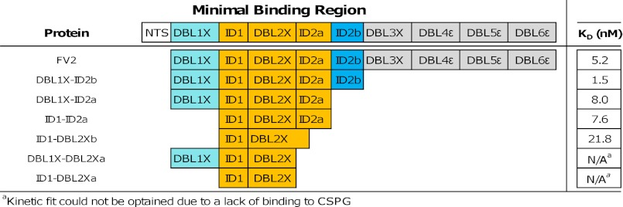
Specific VAR2CSA:CSA binding
Clausen et al.
The core CSA-binding site lies within the DBL2X domain and parts of the flanking inter-domain regions

Slide 9

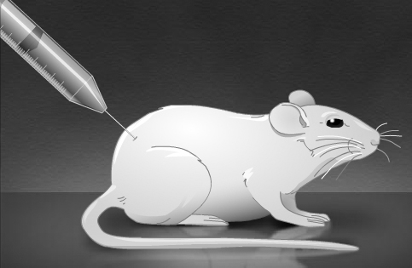
ID1-ID2a inhibit parasite binding
Targets VAR2CSA native protein on the surface of iRBC
Challenges for vaccine development:
Sequence variation
Very large protein (350 kDa)
Polyclonal anti-ID1-ID2a IgG
inhibit parasite binding
Inhibit binding of iRBC to CSA

Slide 10
Aim
Characterization of the specific epitopes responsible for VAR2CSA:CSA binding
  Crystal structure
    DBL3 & DBL6
  Monoclonal antibodies
    From naturally immune women & immunized animals
      -> antibodies against the immune-dominant DBL3 and DBL5
Development of a monoclonal reagent against the part of VAR2CSA responsible for parasitebinding to CSA
Notes:
Important for optimal vaccine design

Slide 11
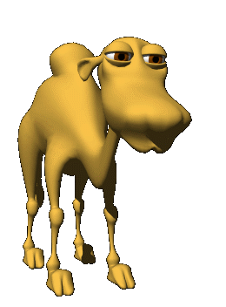
Camelid antibodies - nanobodies
Nbs target unique epitopes
(poorly immunogenic by classical antibodies)
Antigen specific
High affinity for the Ag
Efficient identification of Ag
binders
Good expression yields
Good stability
Good solubility
Nb ≠ scFv = Fab
Nb = Fab = scFv
Nb = Fab = scFv
Nb > scFv = Fab
Nb > scFv=Fab
Nb > Fab > scFv
Nb > Fab > scFv
antigen
CH1
CH1
VH
CH1
VH
VL
CL
VH
Fab
Classical antibody
CH2
Fc
CH3
scFv
antigen
VHH
VHH
VHH
VHH
Camel Heavy-Chain
antibody
Monomeric : 15 kDa
Diameter 2.4 nm
Height 4 nm
CH2
Fc
Smallest intact antigen-binding fragment derived from a functional immunoglobulin
CH3
Hamers et al., Nature, 1993
Notes:
Avoid immune-dominant epitopes
CDR3

Slide 12
VH >< VHH
CDR1
CDR2
CDR3
VH
G44
W47
N
V37
L45
4 conserved residues
framework
3 hypervariable regions
N
VH
VHH
Protrunding
CDRs
C
C
CDR1
CDR2
CDR3
VHH
F37
E44
G47
R45
valine 37 to phenylalanine,
glycine 44 to glutamic acid,
lysine 45 to arginine
tryptophan 47 to glycine
Disulfide bond
solubility
Vu et al., Mol. Immunol., 1997
Desmyter et al., Nat.Struct.Biol., 1996

Slide 13
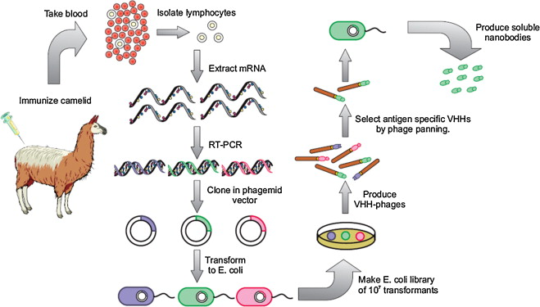
Selection of antigen-specific VHH

Slide 14
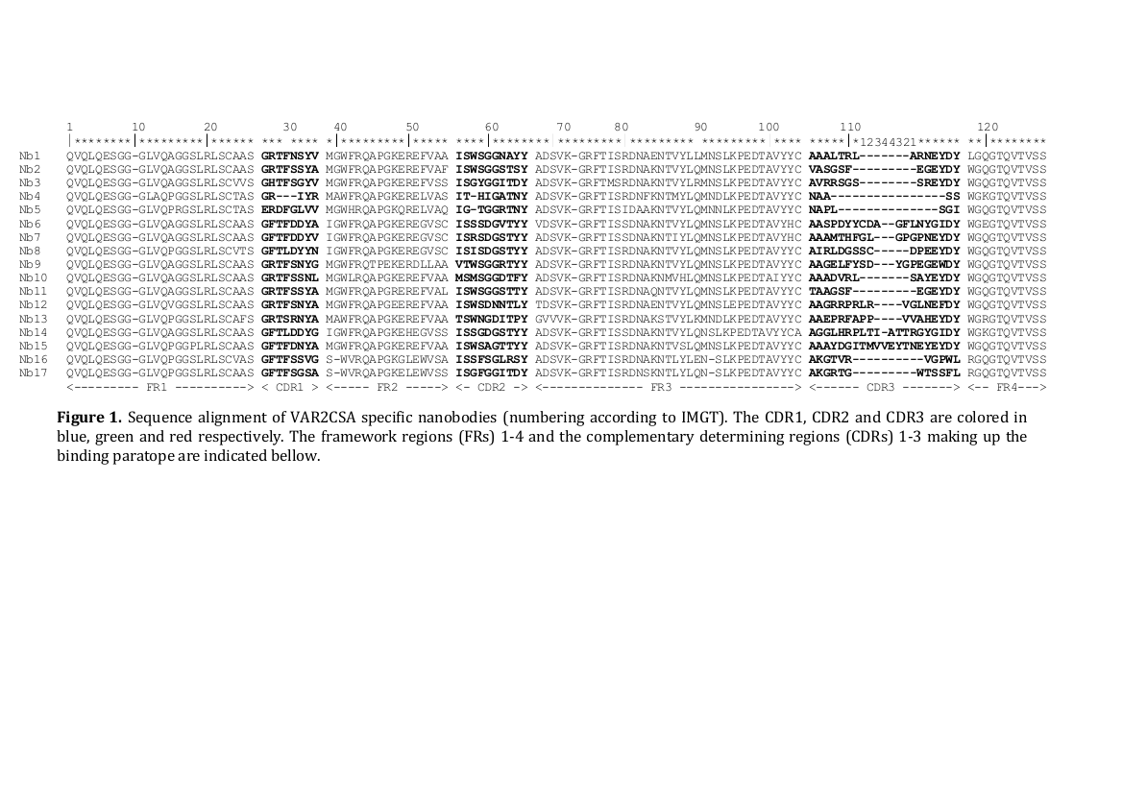
VAR2CSA specific nanobodies
N
Sequencing
the anti-VAR2-positive clones
VHH
C

Slide 15
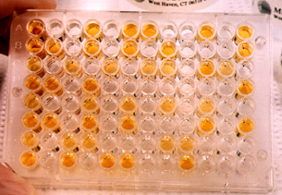
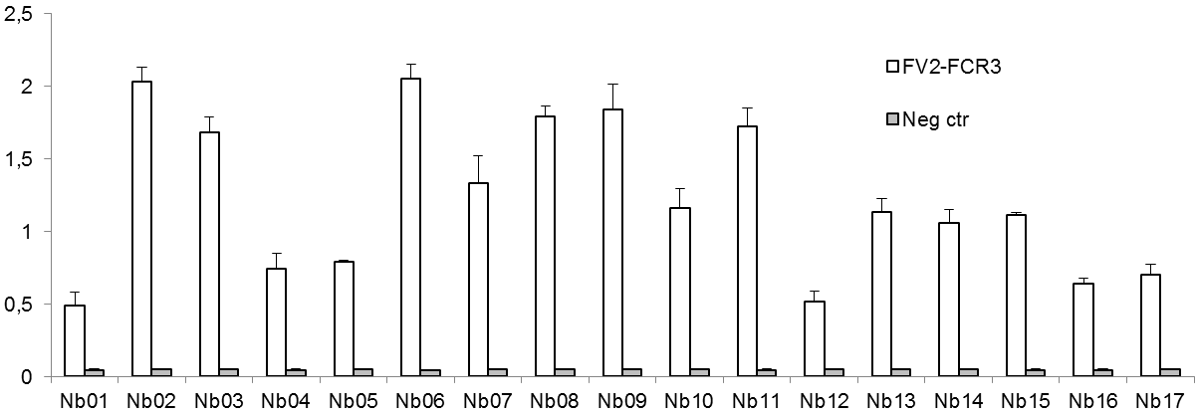
VAR2CSA positive Nanobodies
ELISA:
Anti-camel-HRP
Nanobody
VAR2CSA protein
O.D. 490 nm

Slide 16
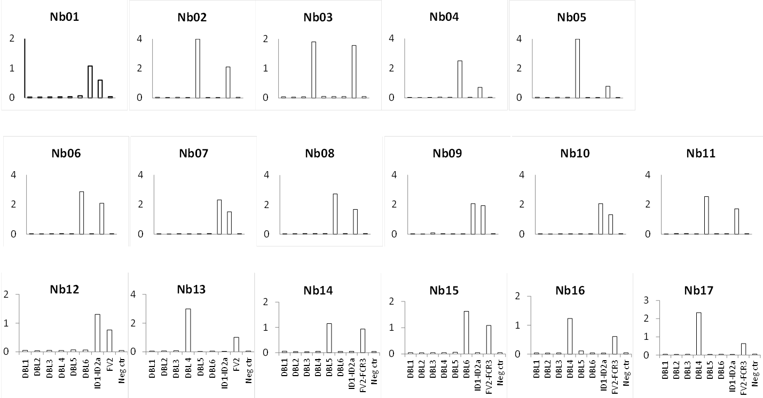
VAR2-domain specific nanobodies

Slide 17
Nb reactivity to VAR2CSA domains
 | DBL1 | DBL2 | DBL3 | DBL4 | DBL5 | DBL6 |  | ID1-ID2a |  | FV2 FCR3
Nb01
Nb02
Nb03
Nb04
Nb05
Nb06
Nb07
Nb08
Nb09
Nb10
Nb11
Nb12
Nb13
Nb14
Nb15
Nb16
Nb17
4 Nbs -> DBL4
4 Nbs -> DBL5
4 Nbs -> DBL6
5 Nbs -> ID1-ID2a

Slide 18
ID1-ID2a specific Nbs
Different protein expression systems
Cross reactivity against 3D7

Slide 19
Structural recognition of Nbs
The single domains DBL4, DBL5, DBL6:
Linear epitope recognized
The ID1-ID2a domain:
Discontinued epitope recognized

Slide 20
VAR2CSA-specific-Nbs recognize native VAR2CSA

Slide 21
ID1-ID2a Nbs reduce parasite binding

Slide 22
Conclusions
Induction of VAR2CSA-specific nanobodies
  Including minimal-binding specific
  Recognition of Plasmodium falciparum infected erythrocytes
  Capacity to reduce parasite binding to the placental receptor (CSA)
  Ongoing:
  Epitope mapping
  Crystallization

Slide 23
Acknowledgement
The VAR2CSA vaccine development group
Ali Salanti (PI molecular biology)
Adam Sander (Post doc)
Anne Corfitz (technician)
Besim Berisha (Technician)
Caroline Pehrson (PhD student)
Christina Holm (Technician)
Ditte Marie (Technician)
Elham Alijazaeri (Technician)
Line Barington (Master student)
Madeleine Dahlbäck (Post doc)
Mafalda Resende (Post doc)
Maria Rasmussen (Technician)
Mette Agerbæk (PhD student)
Mette Hamborg (Post doc)
Morten Nielsen (PI parasitology)
Nahla Chehabi (Technician)
Thomas Clausen (PhD student)
Thor G Theander (Head of dept.)
Susan Thrane (PhD student)
Collaborators
ExpreS2ion Biotechnologies
CMC
Raluca Florea at Vrije Universiteit Brussel
Stefan Magez at Vrije Universiteit Brussel
Philippe Boeuf at The University of Melbourne
The work received funding from:
Danish research Council
Danida
HTF
Bill and Melinda Gates Foundation
University of Copenhagen
Proof of Concept foundation (DTU)
Novo Nordisk Foundation

Slide 24
First clinical trial
A FP7 funded three year program PlacMalVac.
A clinical development of a VAR2CSA-based placental malaria vaccine based on the ID1-ID2a construct.
Including:
- GMP production
- Preclinical tox
- Phase 1a (Germany)
- Phase 1b (Benin)

