Slide 1
Introducing the KCRI ePhD Log
Helen Allwood
Assistant Manager, MCDC

Slide 2
What is the e-PhD Log?
An online resource designed to:
Support students through their PhDs
Support the supervisory relationship
Help the university monitor student progress
Hosted on the KCRI website:

Slide 3
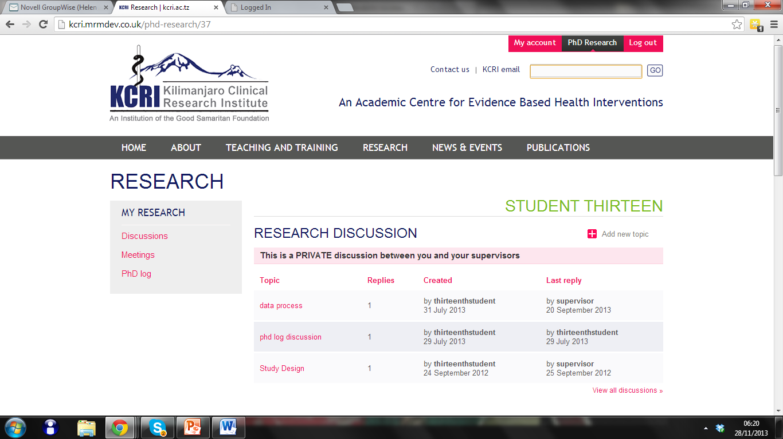
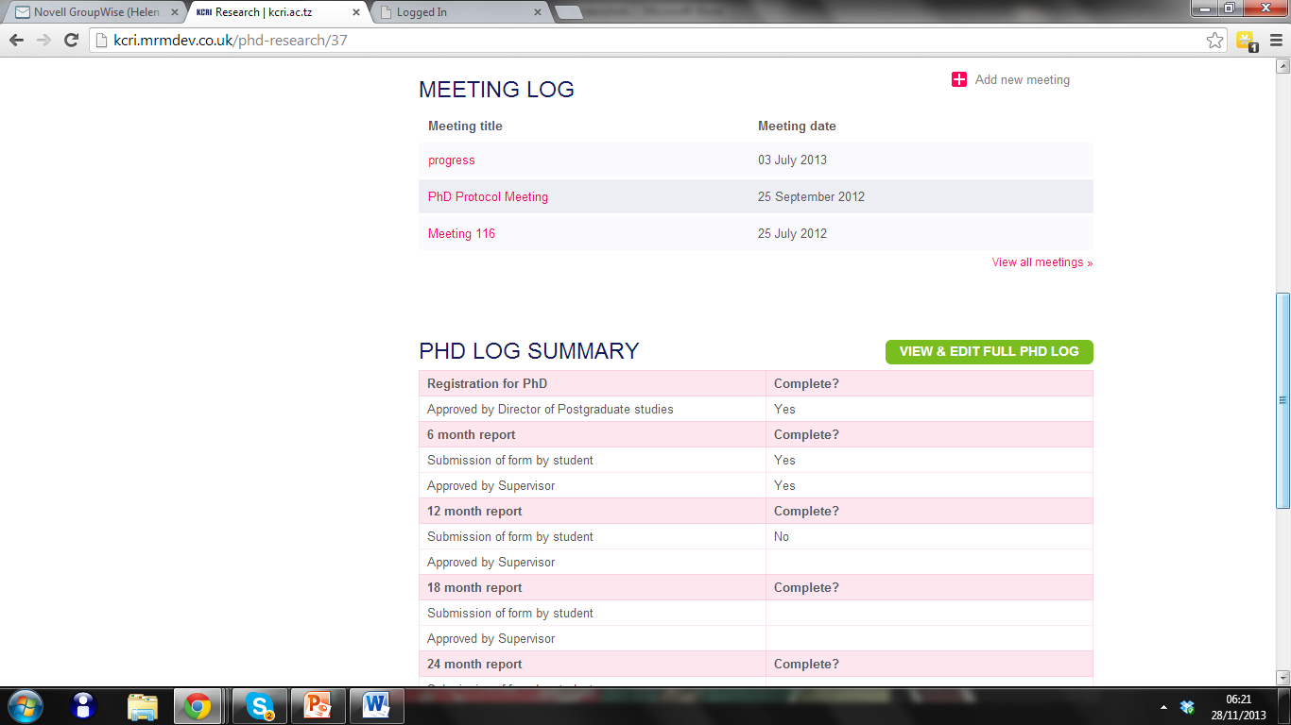

Slide 4
For students the log offers:
Research Discussion – to facilitate discussions between students and supervisors
Meeting Log – to store information from supervisory meetings
PhD Log – to track progress against PhD milestones

Slide 5
This area is for private discussions between students and supervisors
Students can add topics for supervisors to respond to
Store all your research discussions in one place
Notes:
Once a discussion topic is entered by a student an automated email will be sent to their supervisors requesting a response.

Slide 6
Students can add details of meeting discussions and action points here
Supervisors can agree these action points and make comments
Information entered here is private and can only be viewed by Students and their Supervisors.

Slide 7
Meeting Example

Slide 8
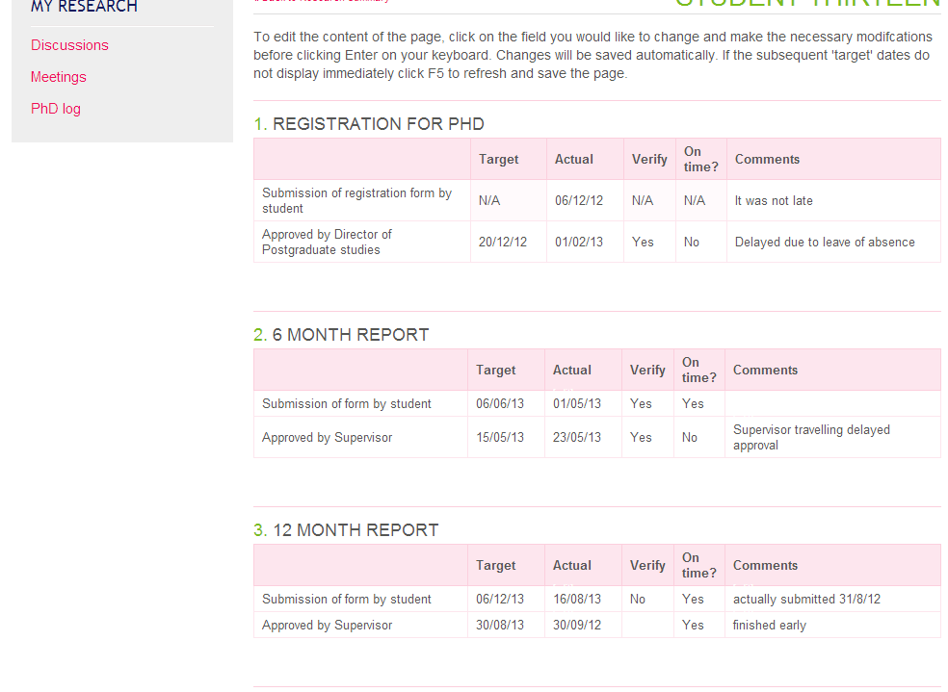
PhD Log
Notes:
As you can see the log consists of:
a series of milestones
target dates for achieving these milestones
actual dates the milestones were achieved
a column for administration to verify the dates
a column noting if the milestones were achieved on time
a section for comments
Students are responsible for completing the actual dates they achieved the milestones.
They can also add information to the comments section (although this is not compulsory).

Slide 9
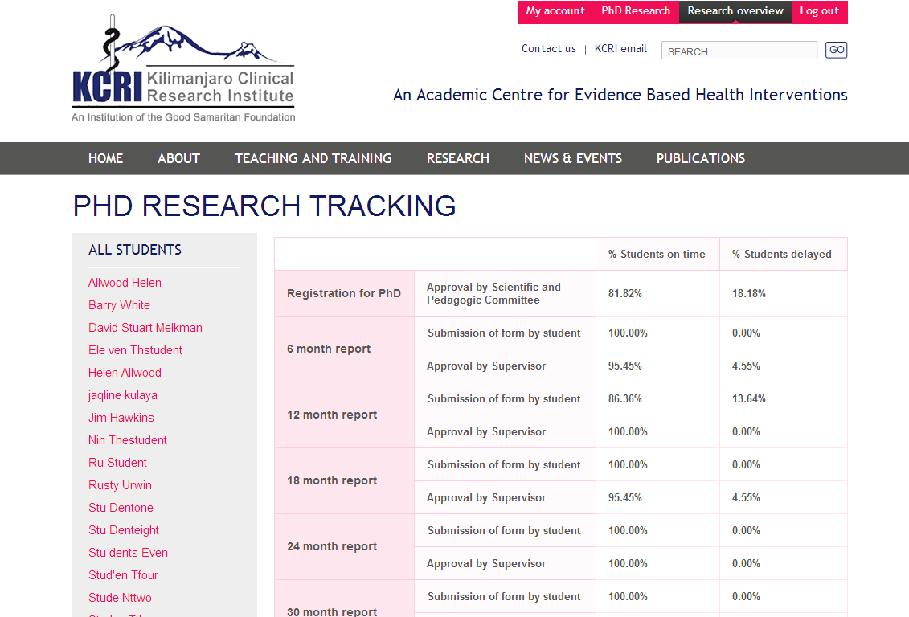

Slide 10
Next Steps
Pilot ePhD Log with 8 students registered 2013 (and their supervisors) for 6 – 12 months
User training
Monitor usage
Gather feedback, review and make changes
More user testing
Works well – Scale Up
Doesn’t work well – Worth fixing? Discard?

Slide 11
Thank You!
All at KCRI, but in particular:
Prof Gibson Kibiki
Jaqline Kulaya
Elizabeth Kussaga
Kennedy Ngowi
Manta Ray Media

